Slide 1
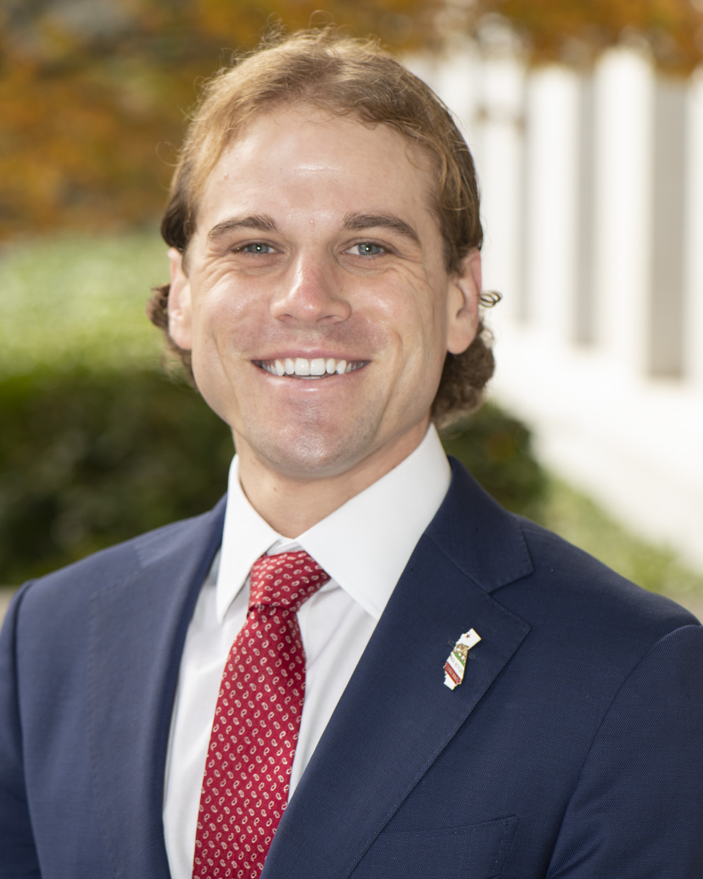
Trelynd D.J. Bradley
Deputy Director, Sustainable Freight and Supply Chain
California Governor’s Office of Business and Economic Development (GO-Biz)

Slide 2
About GO-Biz
Point of contact for economic development and job creation efforts.
Offers services to business owners, communities, and site selectors.
Has a broad range of teams and services, including Permit Assistance, Business Investment Services, Supply Chain, International Affairs & Trade, Office of the Small Business Advocate, External Affairs, California Competes Tax Credit, Zero Emission Vehicles, Energy Unit and more.

Slide 3
GO-Biz Teams
GO-Biz
CalOSBA
IBank
Film
Visit California
Business Investment Services
Office of Permit Assistance
Community & Equity Grants
California Competes
International Affairs & Trade
Energy Unit
Zero Emission Vehicles (ZEV)
Office of Supply Chain
Community & Place-Based Solutions

Slide 4
III. LOSSAN – Critical for Multiple Industries
Tourism
Technology
Manufacturing
International Trade
Life Sciences
Agriculture
Supply Chain and Goods Movement
Materials Including Construction
Defense and Military
Aerospace
Electronics
Energy

Slide 5
III. California - Supply Chain Ecosystem
Building the Supply Chain for Tomorrow
California has one of the country’s most extensive, complex, and interconnected freight systems in the nation.
12 ports. 5/12 facilitate container traffic (Los Angeles, Long Beach, San Diego, Hueneme, Oakland)
2022 – 42.4% of all U.S. container traffic entered through CA
12 airports with major cargo operations
2 Class 1 railroads that are the largest in the nation, and 26 short-line railroads operating over 6,500 miles of track
5,800 commercial miles of high traffic volume Interstate and State highways
3 existing and 1 future commercial land border ports of entry with Mexico
Comeback Guide

Slide 6
III. California - Supply Chain
Meeting Future Demand – Historic 2022-23 Budget Investment
Largest public investment of any state
$15B collectively over four years in transportation investment
Including heavy duty/ZEV and freight electrification supportive funding largest investment of any state in goods movement
Supply chain package: $1.2B Port and Freight Infrastructure - $350M critical grade separation, $30M Data and ports, $150M Goods Movement Campus
Example: CALSTA PFIP $35M to Port of San Diego for National City including rail infrastructure
Comeback Guide

Slide 7
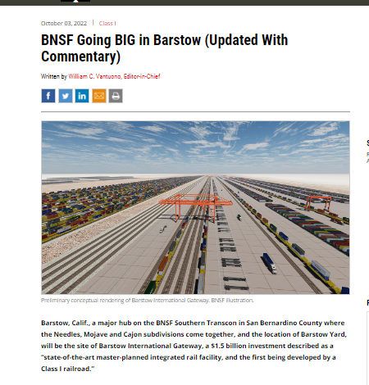
III. California - Supply Chain
Meeting Future Demand – Historic 2022-23 Budget Investment
Increased private investment
Unprecedent state budget investments create opportunities for public-private-partnerships in building capital stack and project development
Example – BNSF International Gateway with direct link to LOSSAN, $1.5B private investment, first inland port facility planned by Class-I railroad in nation
Comeback Guide

Slide 8
California Deepwater Seaports
Port of Los Angeles
6.4 million TEU
59 million tonnage
Port of Long Beach
5.7 million TEU
79 million tonnage
Port of Oakland
2.0 million TEU
19.4 million tonnage
Port of San Diego
76,500 TEU
1.5 million tonnage
Port of Hueneme
100,200 TEU
1.8 million tonnage
Port of San Francisco
2.2 million tonnage
Port of Richmond
21.0 million tonnage
Port of West Sacramento
1.2 million tonnage
Port of Humboldt Bay
Port of Redwood City
1.9 million tonnage
Port of Stockton
4.6 million tonnage
Port of Benicia
Image Sources: California Association of Port Authorities; Port of Benicia.
Data Sources: Bureau of Transportation Statistics, Port Performance Freight Statistics Program, 2020.

Slide 9
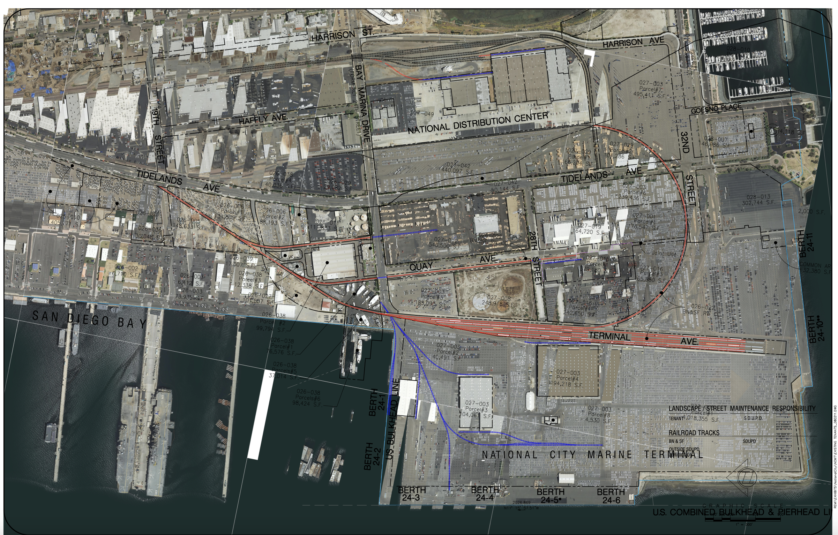
III. LOSSAN - Supply Chain and Goods Movement
Focus on San Diego – Critical to Goods Movement
Port contributes billions to local economy. Home to 800 businesses.
BNSF operates rail subdivision SD section
Port has two marine cargo terminals, 15 berths, on dock-terminal rail.
Breakbulk, project cargo, refrigerated, containers, ro-ro (autos).
Tenth Avenue – 16 rail spurs across three rail yards totaling 13,800 feet in rail service.
National City – 6 rail spurs totaling 9,986 feet in rail service.
A primary BNSF auto facility. Thirteen steamship lines routinely call for vehicle service. Pasha is primary user of rail auto.
Comeback Guide

Slide 10
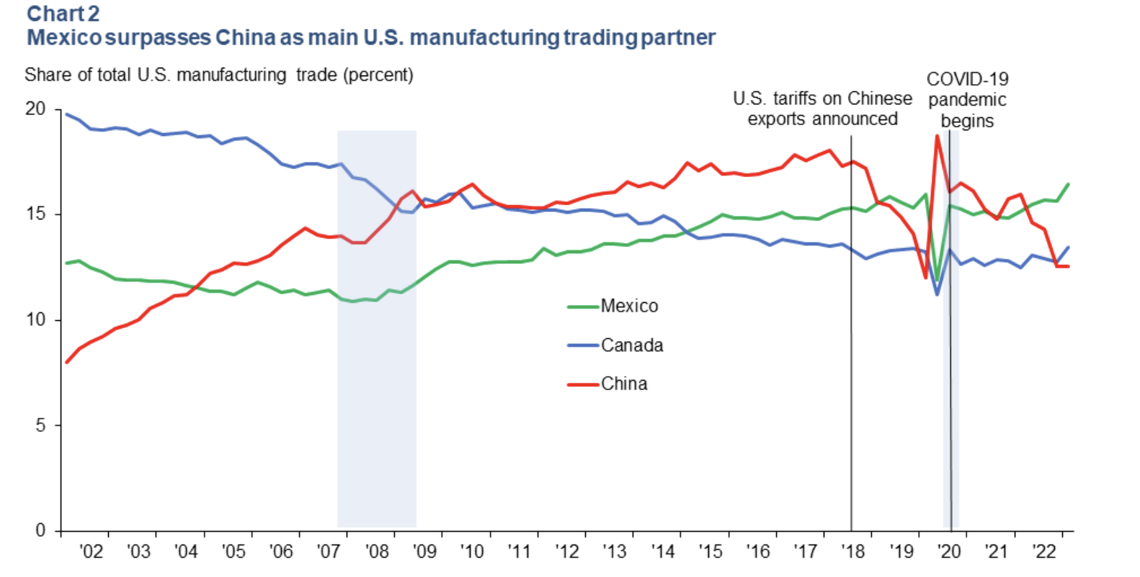
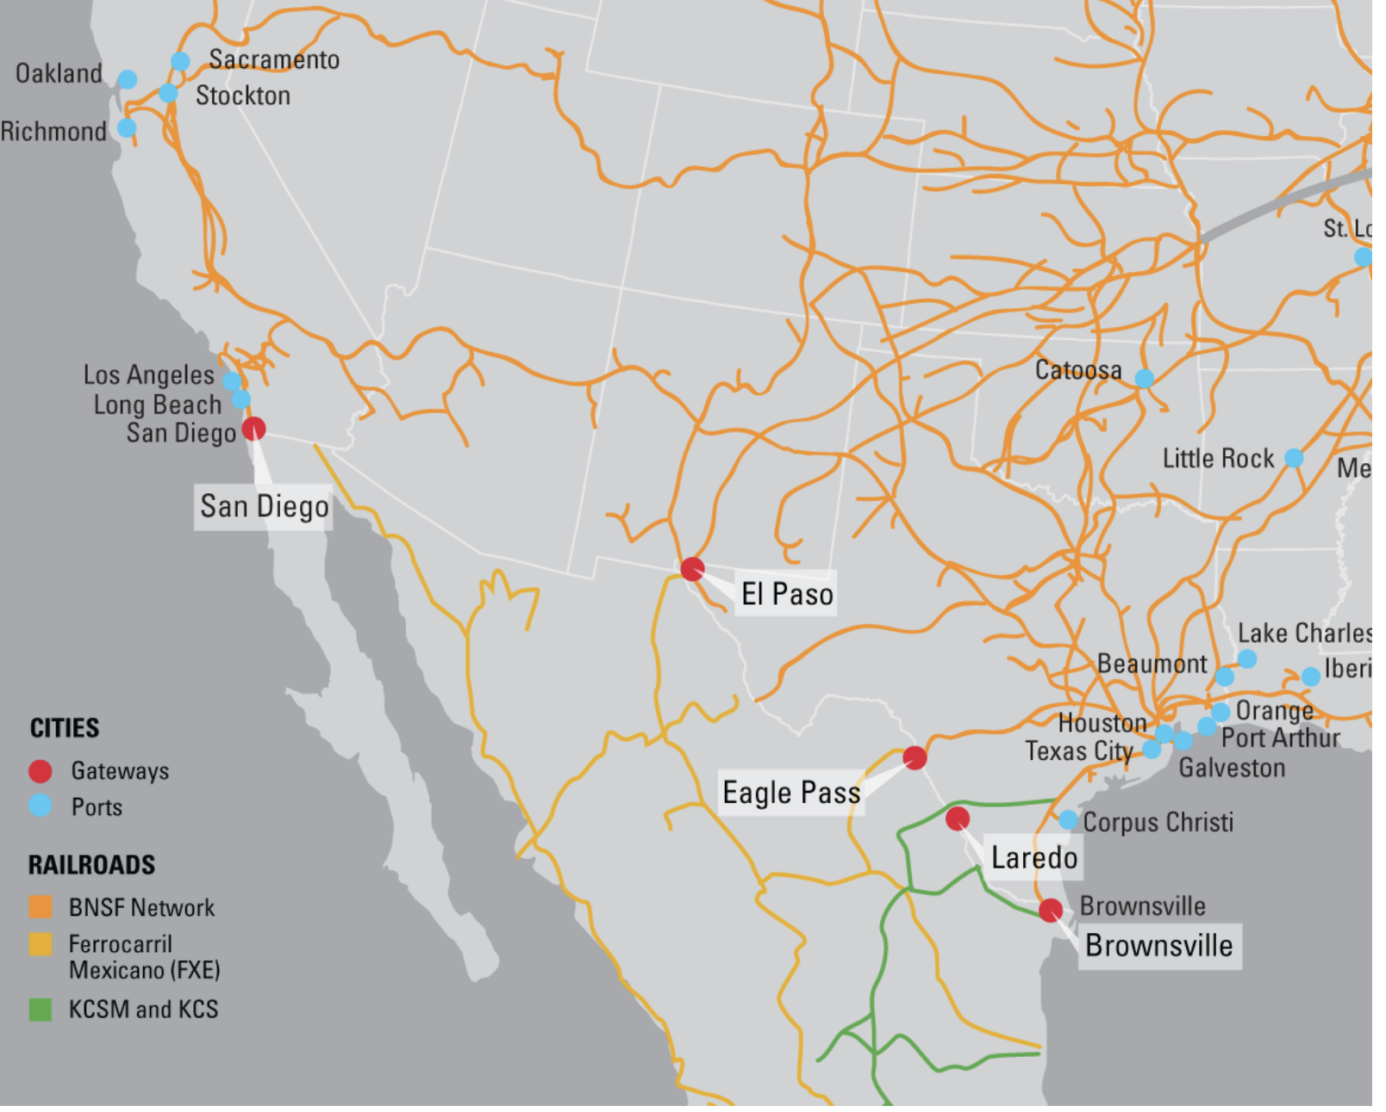
III. LOSSAN - Supply Chain Development
Global Supply Chain Paradigm Shifting
Mexico supplanted China this year as the United States' top trading partner
Global economy > supply chain resiliency
Mexico positioned as manufacturing base
Key alignment on strategic industries including critical minerals, clean economy, CHIPS, defense, vehicles, electronics, etc
Two-way trade via rail, construction <> product
Examples Baja: Toyota, Hyundai, Samsung, Panasonic, Collins, FoxConn, Mytek, FedEx, LMI, Honeywell, Collins, Kenworth, Maxon
Comeback Guide

Slide 11
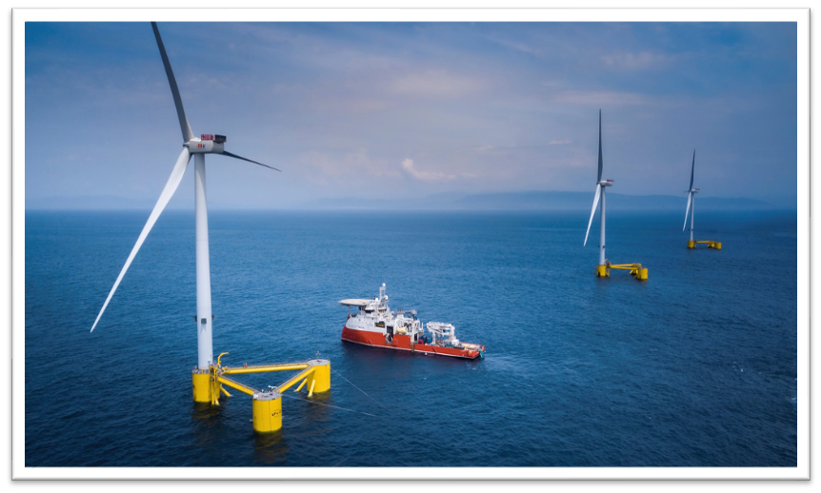
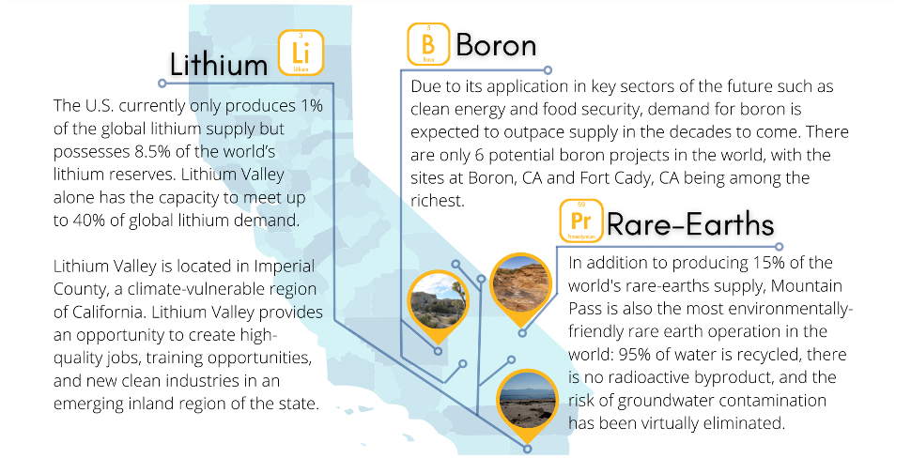
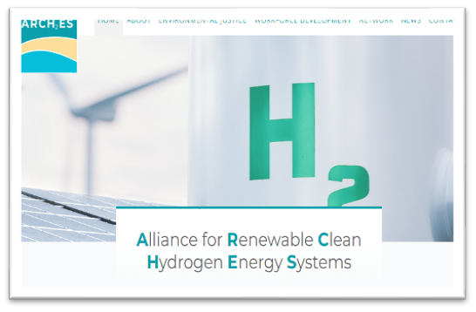
III. LOSSAN - Supply Chain Development
Global Supply Chain Paradigm Shifting
Clean economy, semiconductors, hydrogen, critical materials, defense, offshore wind
Comeback Guide

Slide 12
III. California and Defense
California is home to the nation’s largest concentration of military personnel and national security activity.
Defense produces $158.2B in economic impact across CA, direct and indirect ($15.5B of that supply chain activities alone).
Defense activity generates 762,000 full-time equivalent jobs for residents of the State of California.
National security activity generates $20.7B in tax revenue for federal, state and local governments. (Fed $13.1B, State and Local $7.6B.
10% of global aerospace industry. 25% of total U.S. market.
Source: 2022 California Statewide National Security Economic Impacts Study – California Research Burea, Department of Defense, Governor’s Office of Planning and Research (OPR), Governor’s Military Council
Comeback Guide

Slide 13
III. LOSSAN and Defense
21 military bases/assets across counties, (inc auxi and hospital)
Includes NBSD – second largest surface ship base of Navy, MCBCP – major West coast base for Marines, VSFB and LA – Space Systems Command for Space Force
Of the $158.2B in economic impact across CA, $103.2B of that concentrated in LOSSAN six counties
Of the 762K full-time equivalent jobs in defense for residents of the of California, 376K concentrated in LOSSAN six counties
Example Firms: General Atomics, BAE Systems, Raytheon, Boeing, Northrop Grumman, NASSCO, General Dynamics, SpaceX, Lockheed Martin, Cubic, Relativity Space, RocketLab, Aerojet
Comeback Guide

Slide 14
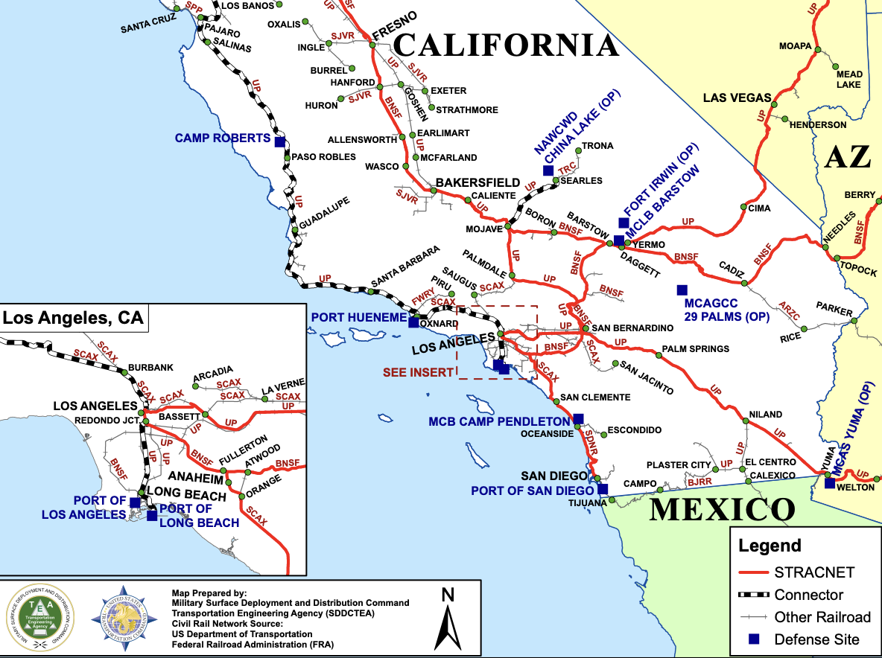
III. LOSSAN and Defense
San Diego section is part of STRACNET, Strategic Rail Corridor Network, BNSF provides ad-hoc DOD delivery services including vehicles, equipment, and construction materials
Deployment - 2021 US GAO Study found 67% of U.S. Army’s transportation of equipment + goods is done via rail from base to port during contingencies
Broader defense apparatus benefits from resilient commercial rail operations
Comeback Guide

Slide 15
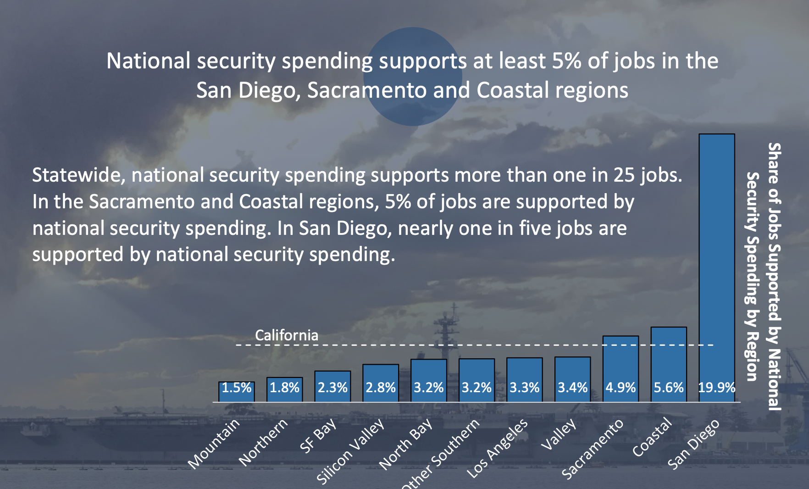
III. LOSSAN and Defense
Comeback Guide

Slide 16
V. Financing Infrastructure
Public Agency or Authority
Private Entity
Local Financing Mechanisms
IBank
Treasurer’s Office
Exempt Facilities Bonds
California Financing
Other Conduit Revenue Bonds
IBank
Treasurer’s Office
Industrial Development Bonds
Tax Increment Financing
Exempt Facilities Bond
GoGreen Energy Financing
Clean Energy Bond Financing
Bonds
Conduit Revenue Bonds
Enhanced Infrastructure Financing District
Tax Exempt Bond Via Financing Authority
Infrastructure and Revitalization District
Climate Resiliency Districts
Infrastructure State Revolving Loan Fund
Public Agency Revenue Bonds
Climate Catalyst Fund
Industrial Development Bonds
Capital Access (CalCAP)
Small Business Finance Center
Climate Tech Finance
Climate Catalyst Fund
Clean Energy Bond Financing
GoGreen Energy Financing
Special Assessment Bonds / Mello-Roos
Local Agency Obligation Bonds / Revenue Bonds
Federal Lending/Finance
Opportunity Zones
New Market Tax Credit (NMTC)
Federal Tax Credit - Elective Pay
Private Lending
Community Lending / CDFI's
Other Districts

Slide 17
V. Tax Increment Financing
Long-term value capture to build infrastructure and service clean projects V
Utilizes increment and value-capture of property – either property tax or an in-lieu (like possessory interest)
Enhanced Infrastructure Financing District
Examples – Port of SF, Orange County/Placentia (rail centric), La Verne (rail centric))
Ability to fund rail and rail supportive infrastructure including projects that deal with environmental, energy, economic competitiveness, resilience,
Comeback Guide
Link Here

Slide 18
Thank you!
supplychain@gobiz.ca.gov
Business.ca.gov

