Slide 1
Senate Transportation Subcommittee on LOSSAN Rail Corridor Resiliency
Informational Hearing – August 15, 2023

Slide 2
Agenda Item III:
Benefits of the LOSSAN Rail Corridor
Informational Hearing – August 15, 2023

Slide 3
The LOSSAN Rail Corridor Today
Significant passenger rail corridor today –Intercity and Regional
Freight - direct connection from major ports to domestic markets
Vital asset for national defense (STRACNET)

Slide 4
The State Rail Plan Vision for the Corridor
Potential for Millions More Riders per Year in this Corridor
Intercity and Regional Rail Integrated with Local Transit
Will Connect Numerous Destinations Across SoCal Frequently Throughout the Day
Service Will be Operated with Zero-Emission Trains
Submitted to FRA’s Corridor Identification and Development Program (CIDP)

Slide 5
Agenda Item IV:
Future Threats to the LOSSAN Rail Corridor
Informational Hearing – August 15, 2023

Slide 6
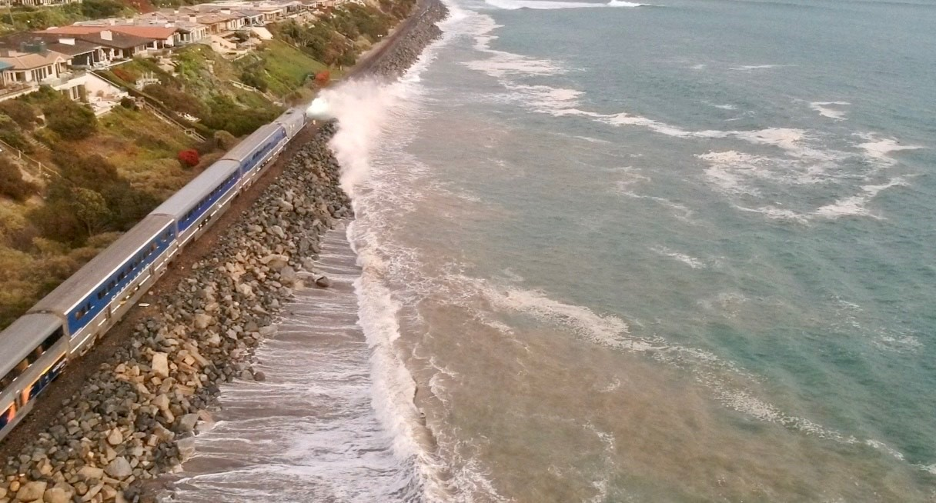
Threats to the LOSSAN Rail Corridor
Sea level rise, flooding, and erosion
Northern portion of corridor is not immune
Need to ensure reliability of corridor today to capture future potential
Photo provided by OCTA

Slide 7
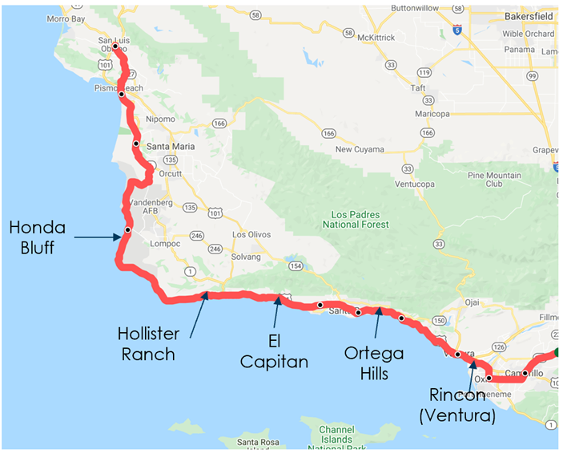
Future Threats to LOSSAN Rail Corridor

Slide 8
Agenda Item V:
Federal and State Investment
Informational Hearing – August 15, 2023

Slide 9
Shutdowns Impact Funding for Capital Projects and Operating Costs
Operating cost impact of San Clemente shutdowns
Emergency funding approaches for San Clemente and Del Mar Bluffs repairs

Slide 10
State and Federal Funding Sources
Current State Funding Sources
Transit and Intercity Rail Capital Program (TIRCP)
State Rail Assistance (Intercity and Regional)
SB1 Programs
Trade Corridor Enhancement Program (TCEP)
Solutions for Congested Corridors Program (SCCP)
State Local Partnership
State Transportation Improvement Program
Transportation Development Act Sources

Slide 11
State and Federal Funding Sources
Local Sources
Sales tax measures (e.g., TransNet)
Potential Federal Funding Sources:
Fed-State Partnership for Intercity Passenger Rail
“PROTECT” Program
Consolidated Rail Infrastructure and Safety Improvements (CRISI) Program
Major Project Development Grants (MPDG) Program (E.g., RAISE, INFRA, MEGA)
Rail Crossing Elimination Program
Amtrak National Network Grants
Federal Transit Administration Funding

Slide 12
State and Federal Funding Sources
Need regional and statewide corridor advancement and funding strategy
Likely insufficiency of currently known grant and capital funding sources
Potential role of financing tools (repaid by owners and users)

