Slide 1
Senate Committee on Transportation
Informational Hearing: Autonomous Vehicles in California
March 24, 2026

Slide 2
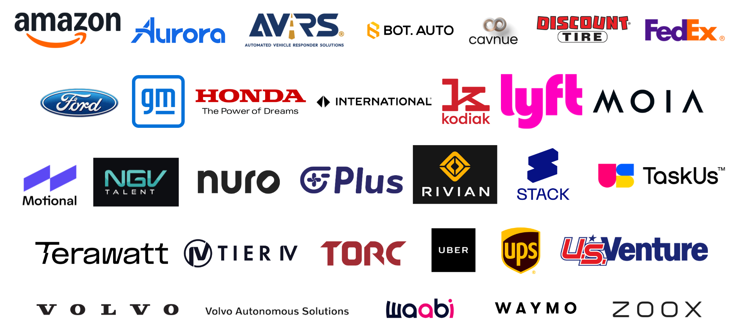
Our Members

Slide 3
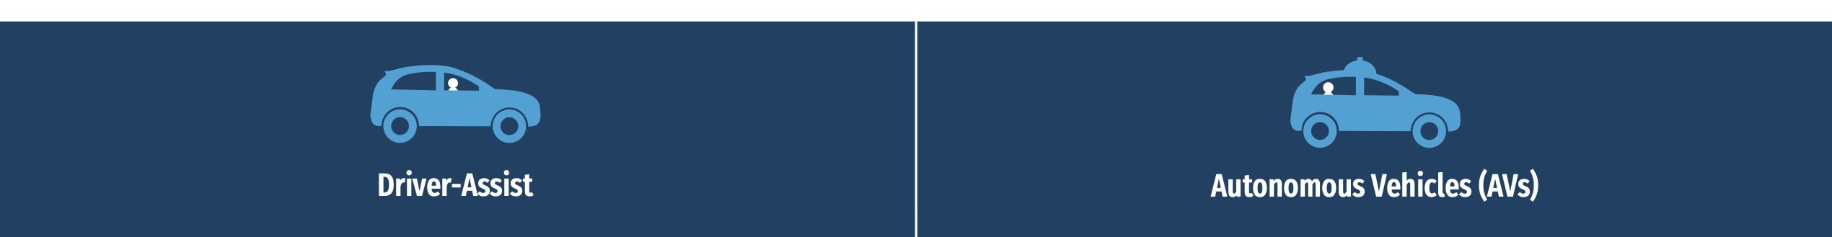
What is an autonomous vehicle?
Requires a licensed, attentive human driver behind the wheel at all times to monitor the roadway and take over driving immediately, if needed.
Examples include:
Lane-Keeping Assistance
Automatic Emergency Braking
Adaptive Cruise Control
Forward Collision Warning
The AV performs the entire driving task.
SAE Level 4 or 5 vehicle
People in the vehicle are only passengers.
Programmed to detect and safely respond to emergency vehicles and law enforcement.
Prior to driving autonomously on public roads, AVs undergo rigorous development and testing in computer simulation, on test tracks, and with trained safety drivers.

Slide 4
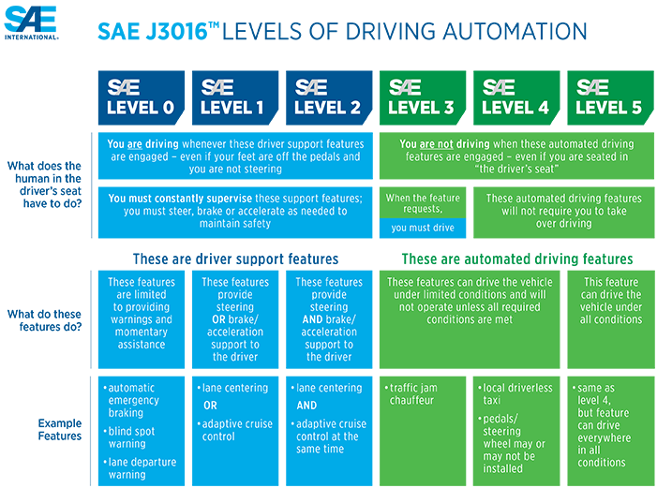






Autonomous Vehicles
Sample Use Cases
 | Trucking; Ride-hailing
 | Middle mile delivery
 | Ride-hailing
 | Trucking
 | Ride-hailing
 | Ride-hailing

Slide 5
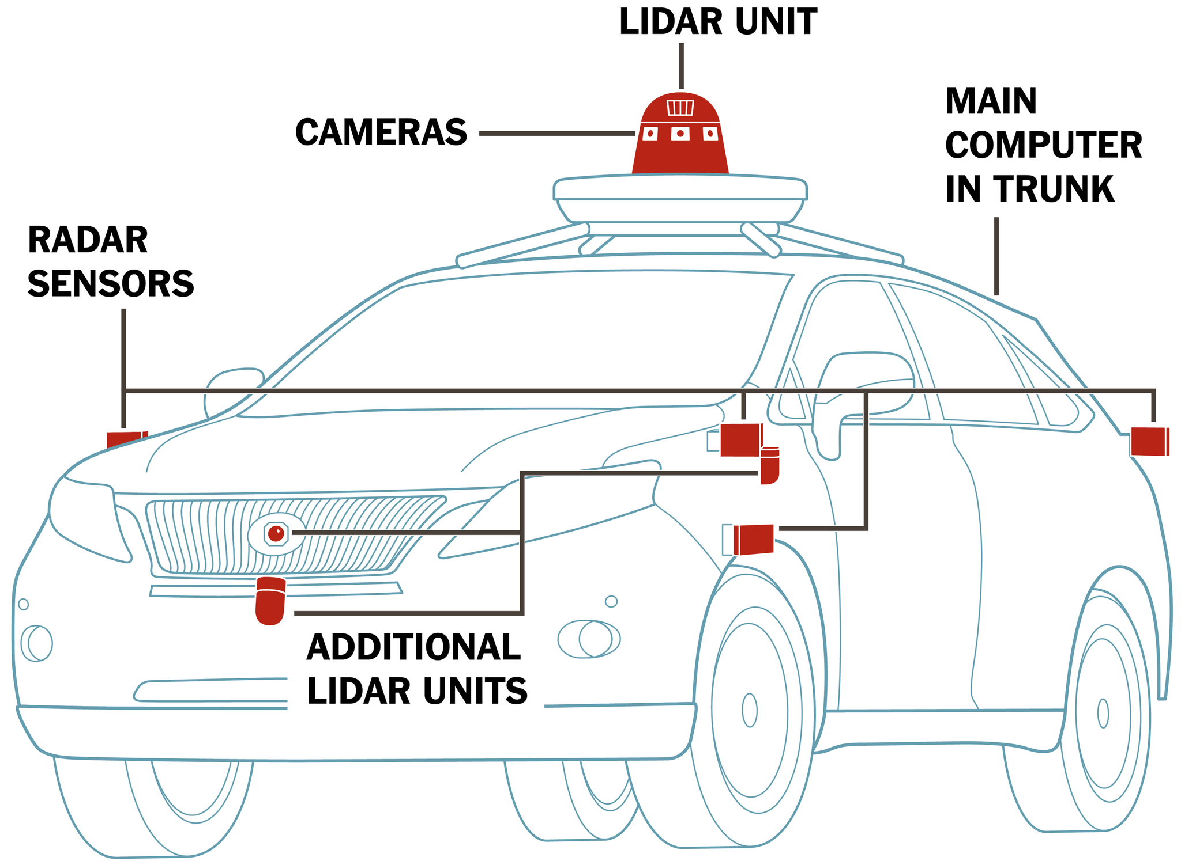
How do autonomous vehicles work?

Slide 6
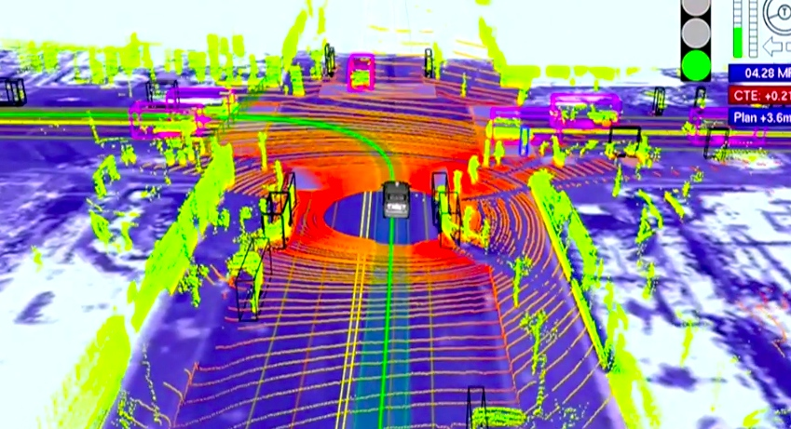
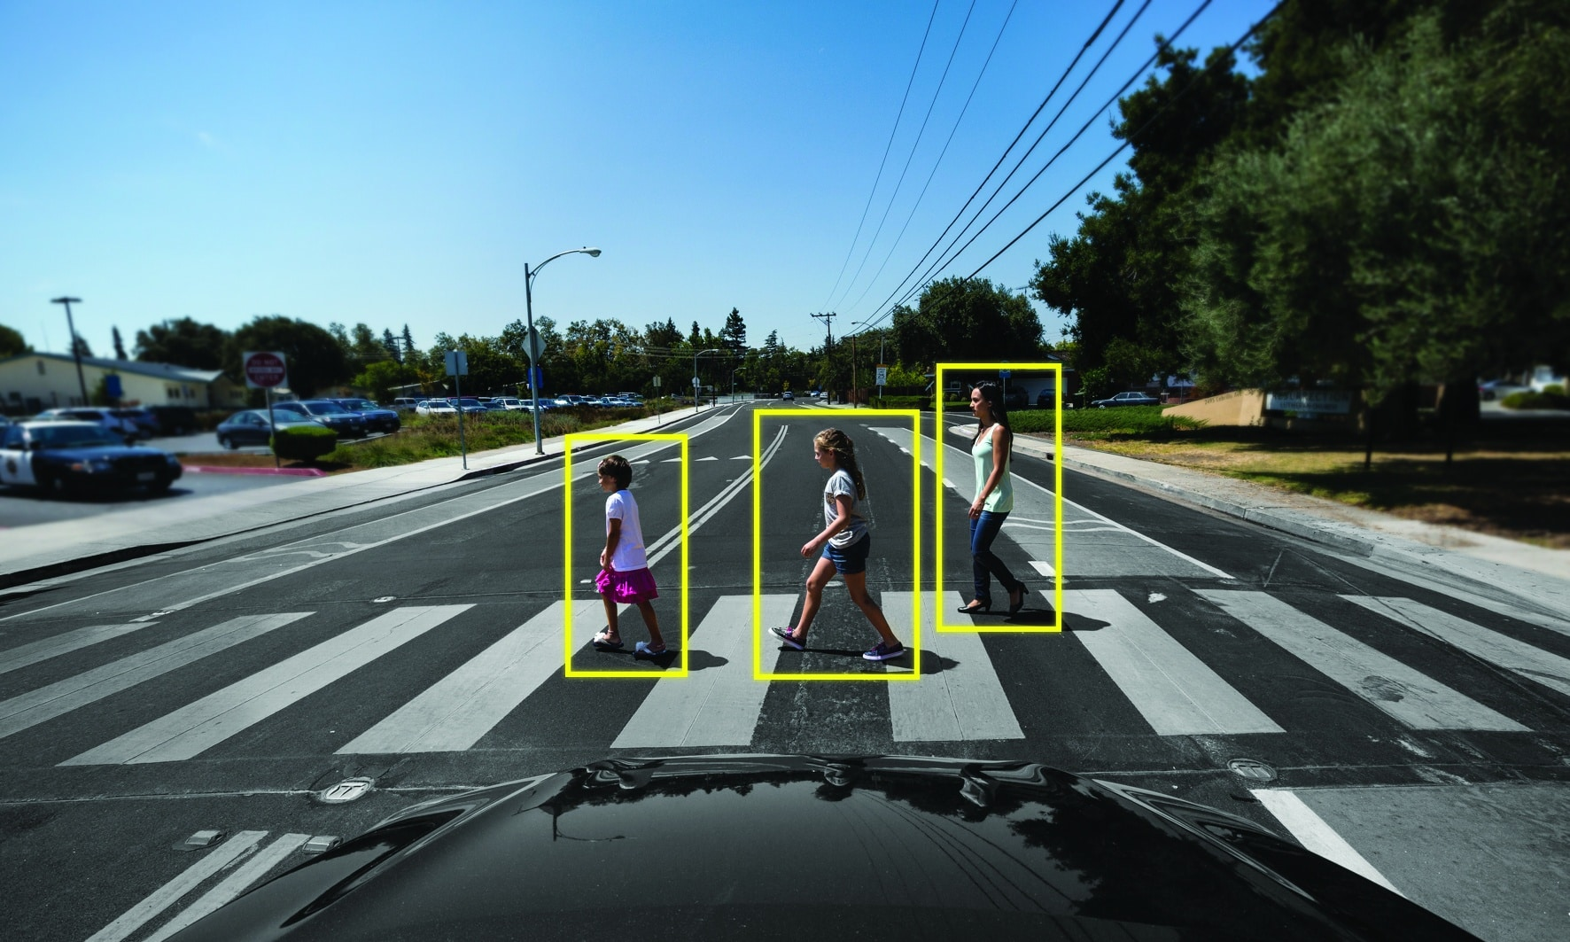
What do autonomous vehicle see?

Slide 7
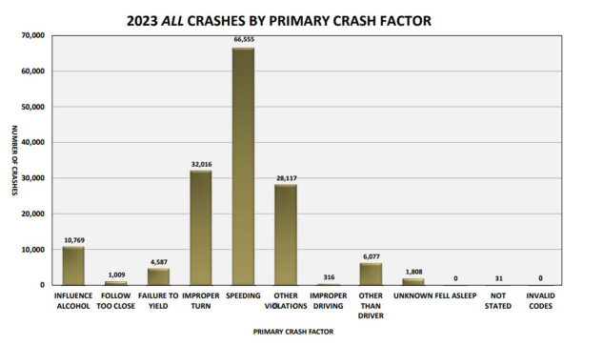

Slide 8
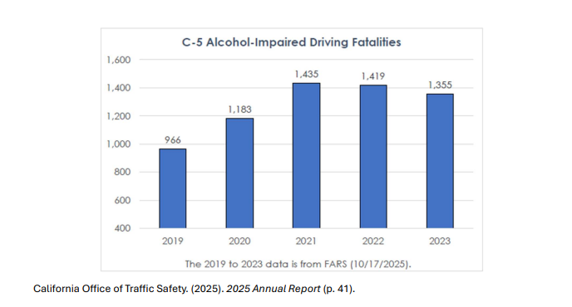

Slide 9
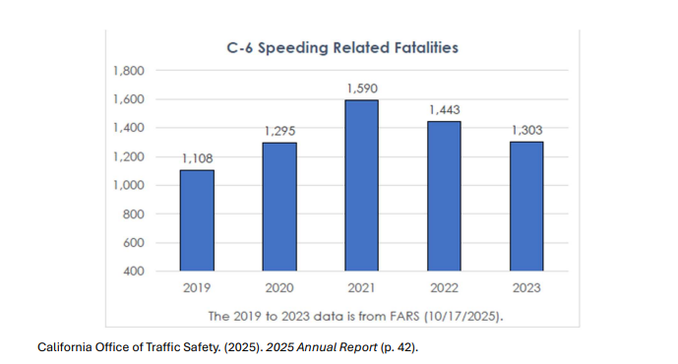

Slide 10
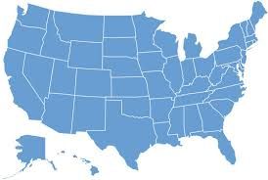
AVs on the Roads
May Mobility shuttles serve MN residents
Zoox testing AVs in Austin, Atlanta, DC, Los Angeles, Miami, and Seattle
Waymo is testing in cities across the United States
Zoox operates robotaxis in Las Vegas and San Francisco
Gatik is completing daily deliveries with its AV trucks in Arkansas, Texas, and Arizona
Waymo operates robotaxis in Austin, Atlanta, Los Angeles, Miami, Phoenix, and San Francisco
Aurora is hauling freight in Texas, New Mexico and Arizona
Kodiak is hauling freight in Texas and New Mexico
Volkswagen testing AVs in Austin

Slide 11
info@theavindustry.org
www.theavindustry.org

