Slide 1
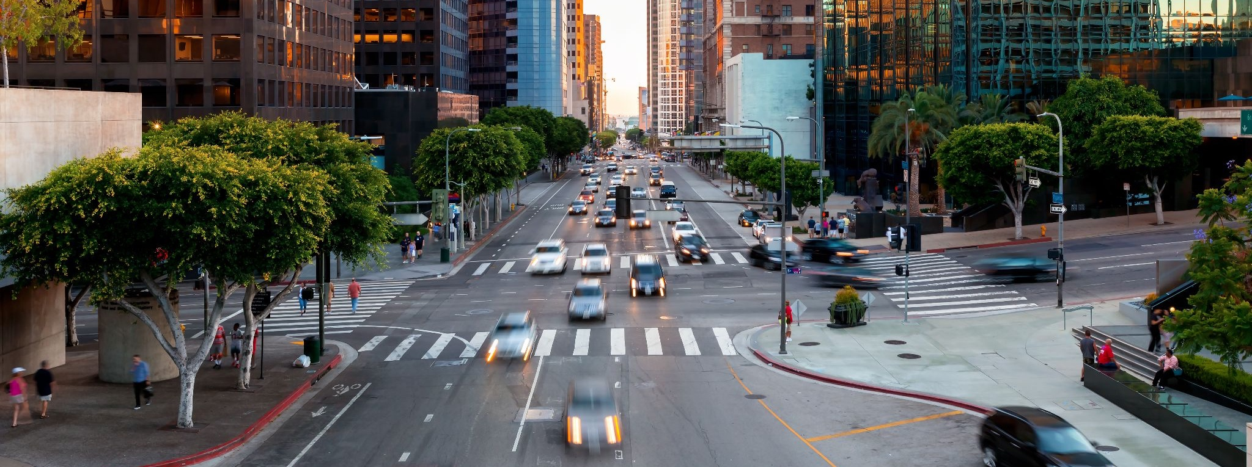

Traffic Safety and DUI Prevention Strategies
Julia B. Griswold, PhD
Joint Informational Hearing
California Senate Public Safety & Transportation Committees
March 10, 2026

Slide 2
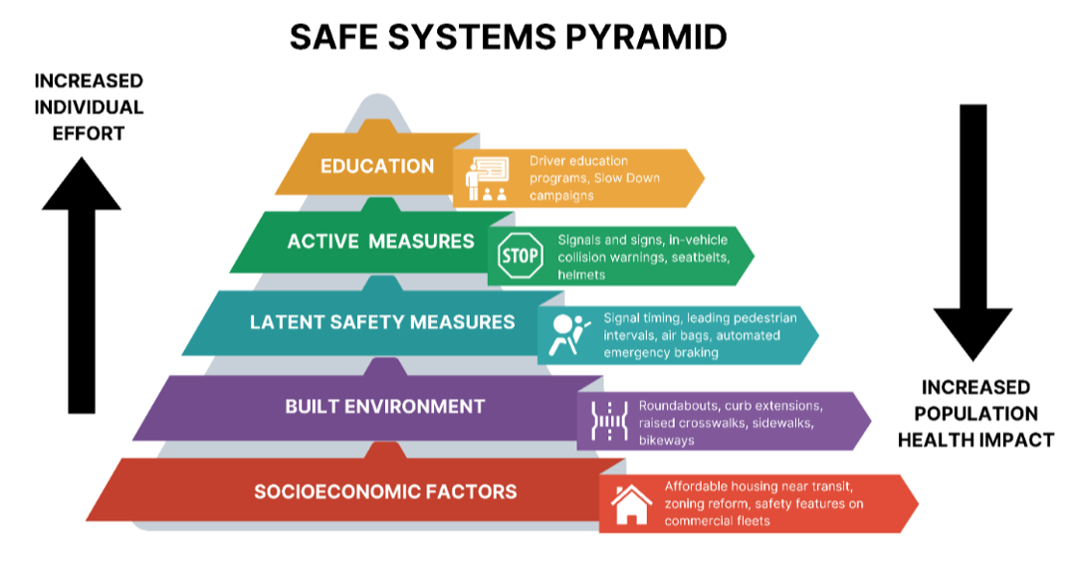
Safe System Approach
Source: Watkins and Lieberman (2025)
Notes:
Review important principles
Prioritize systemic solutions
Point out role of land use

Slide 3
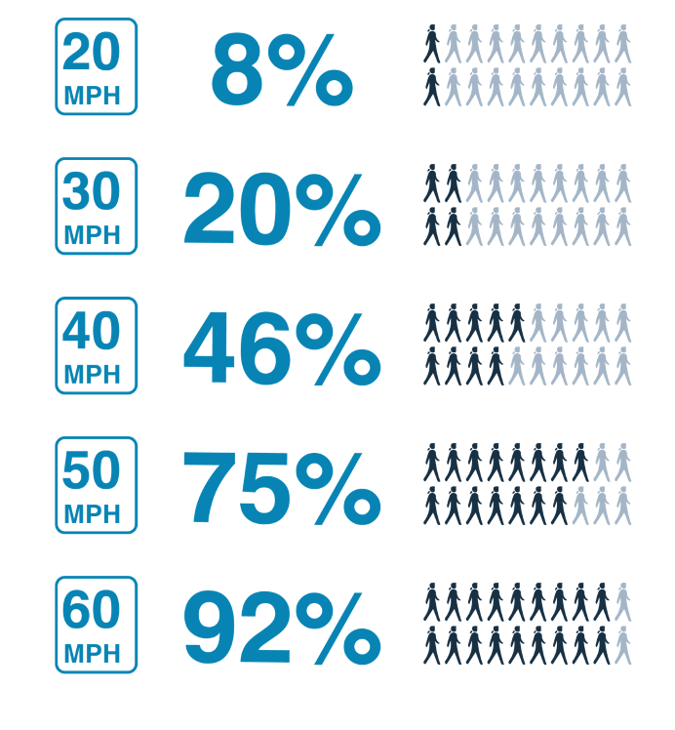
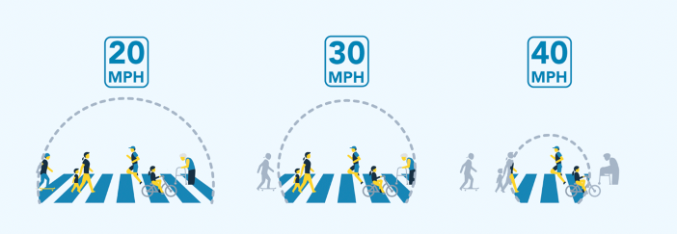
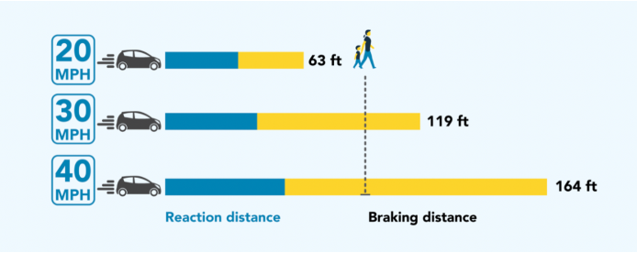
Speed is a primary risk factor in traffic injuries and fatalities
Impacts on Crash Risk
Impacts on Fatality Risk
Source: NACTO Urban Street Design Guide (2013);
Figure: Vision Zero Network
Source: Data from NHTSA (2015);
Figure: Vision Zero Network
Source: Data from Tefft 2013;
Figure modified from: Vision Zero Network

Slide 4
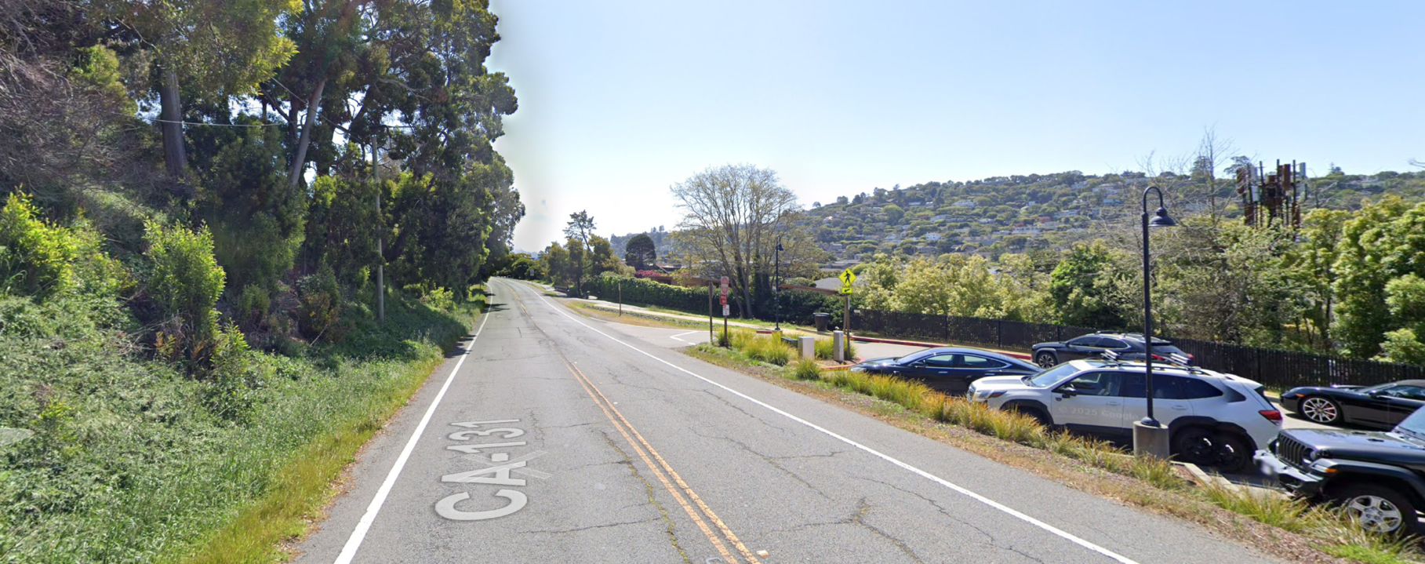
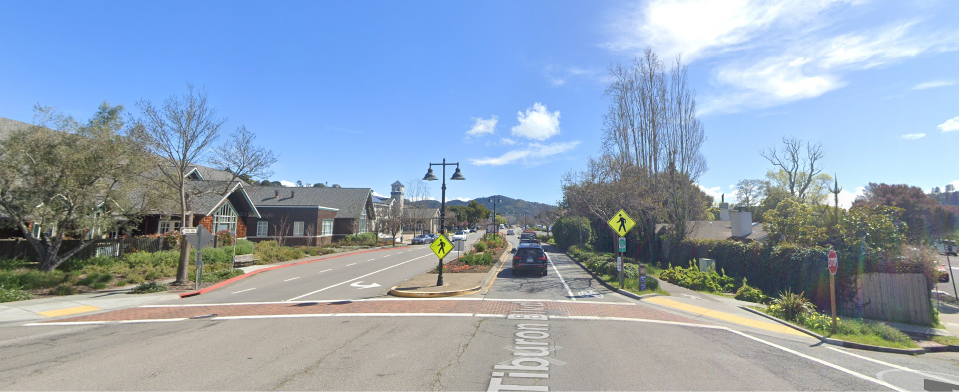
Effective approaches to reduce speeds
Design self-explaining roads
Set appropriate speed limits for the context
Intelligent Speed Assistance (ISA)
Speed safety cameras
Source: Google Street View

Slide 5
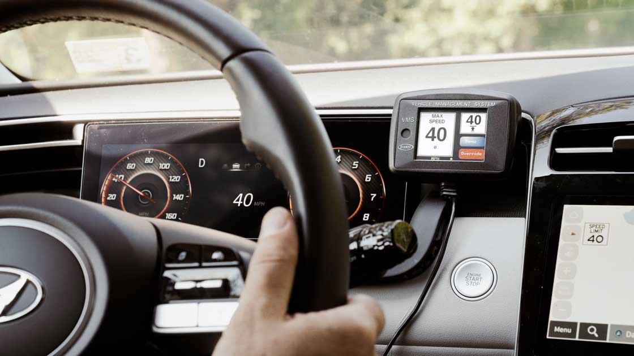
How Intelligent Speed Assistance has been used in the U.S.
NYCDOT Fleet ISA Pilot program
64% relative decrease in time spent speeding (Yahoodik et al. 2024)
Super Speeder Laws
Requires ISA for repeat or excess speeding offenders
Passed in Virginia, Washington, and District of Columbia in 2024-5
Source: IIHS

Slide 6
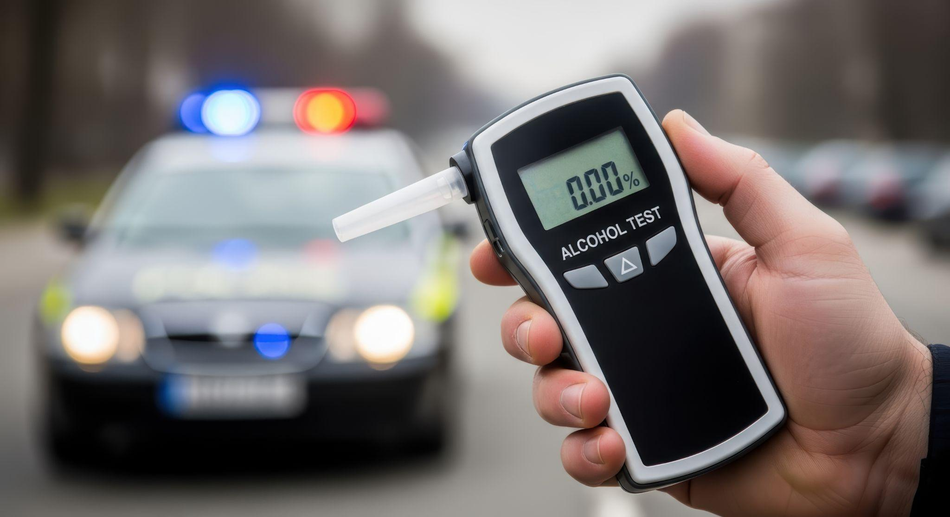
Effective approaches to reduce DUI
General deterrence
  Sobriety checkpoints
  Per se BAC reduction
  Administrative per se
  suspension
Specific deterrence
  Ignition interlock devices
Considerations: Unintended consequences of harsh penalties

Slide 7
Conclusions
Source: Watkins and Lieberman (2025)

