Slide 1
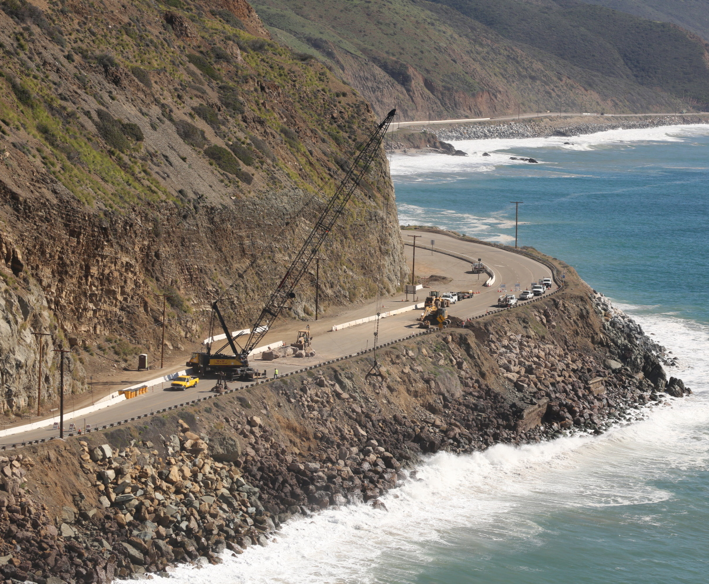
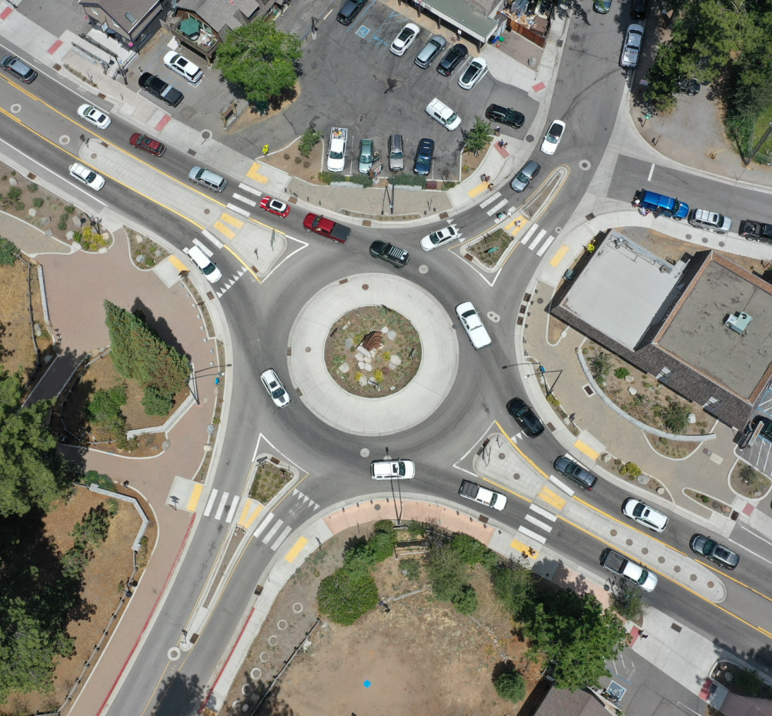
Director Tony Tavares
California Department of Transportation

Slide 2
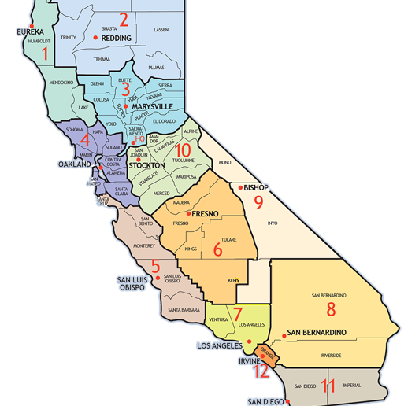
12 districts
23,000 employees
50,000+ lane miles
20,000 bridges
State-supported rail, aviation facilities

Slide 3
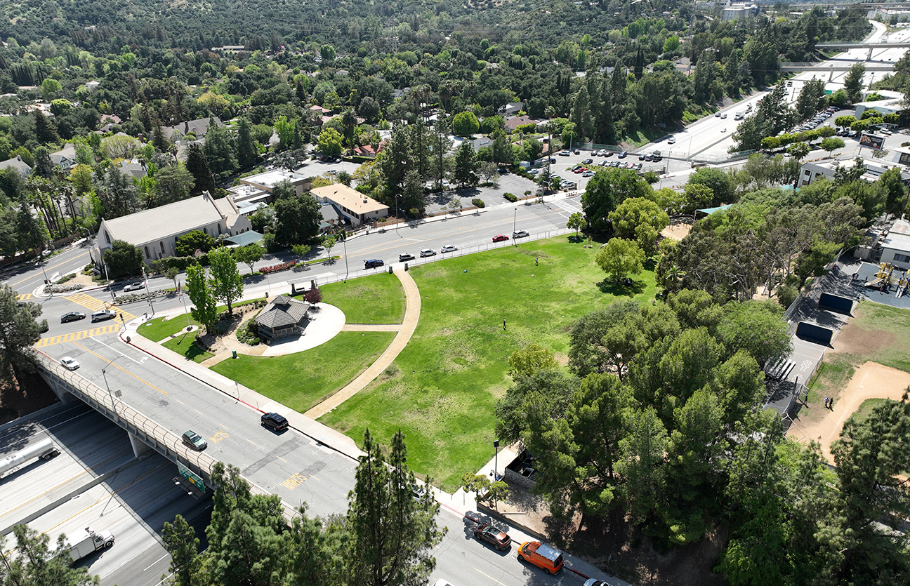
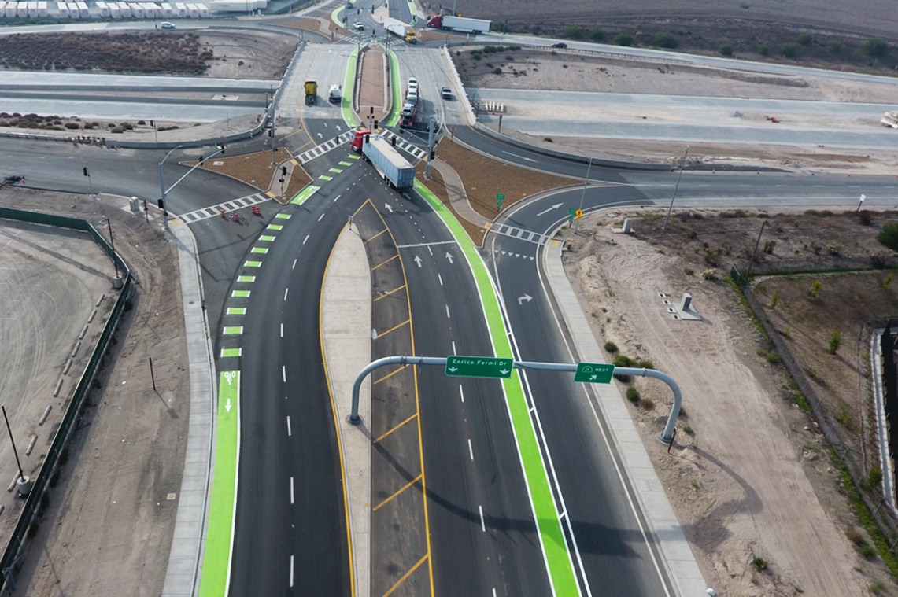
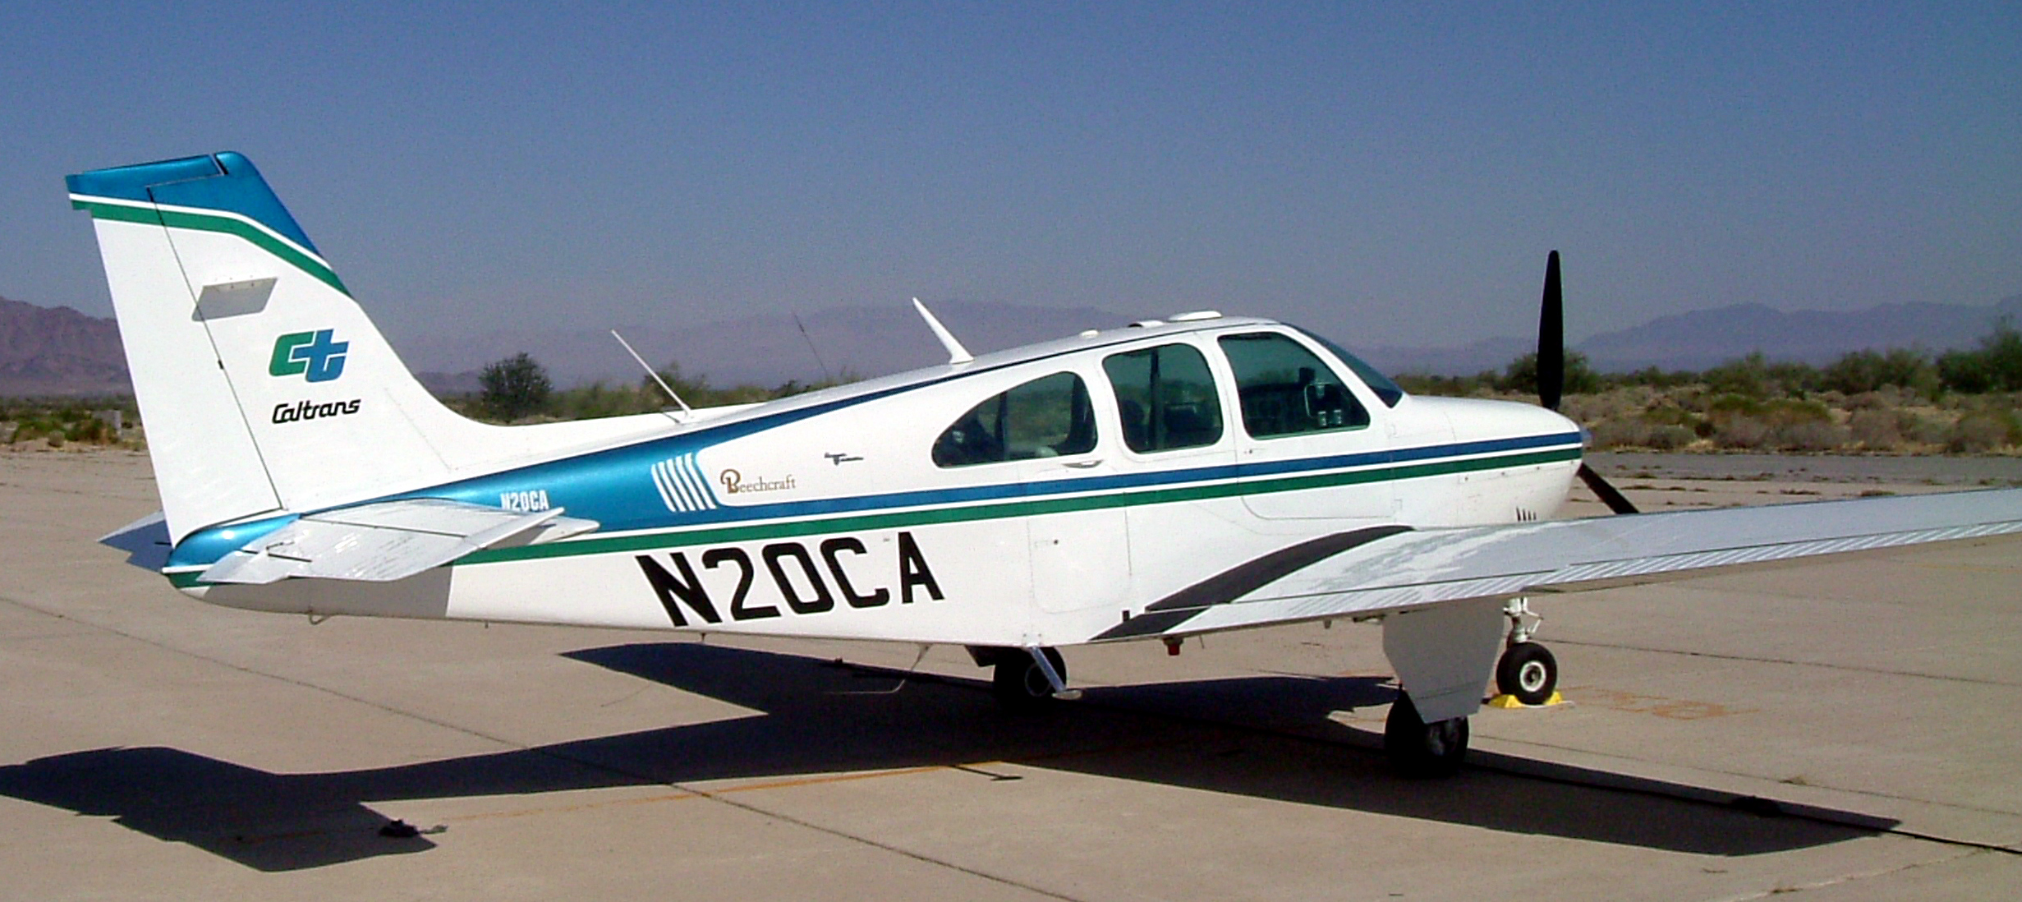

Slide 4
on all SHS and non-SHS California Roadways

Slide 5
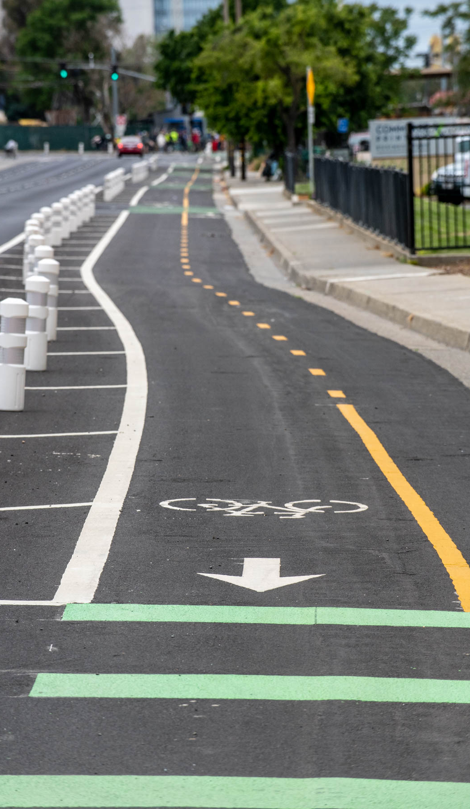

Slide 6
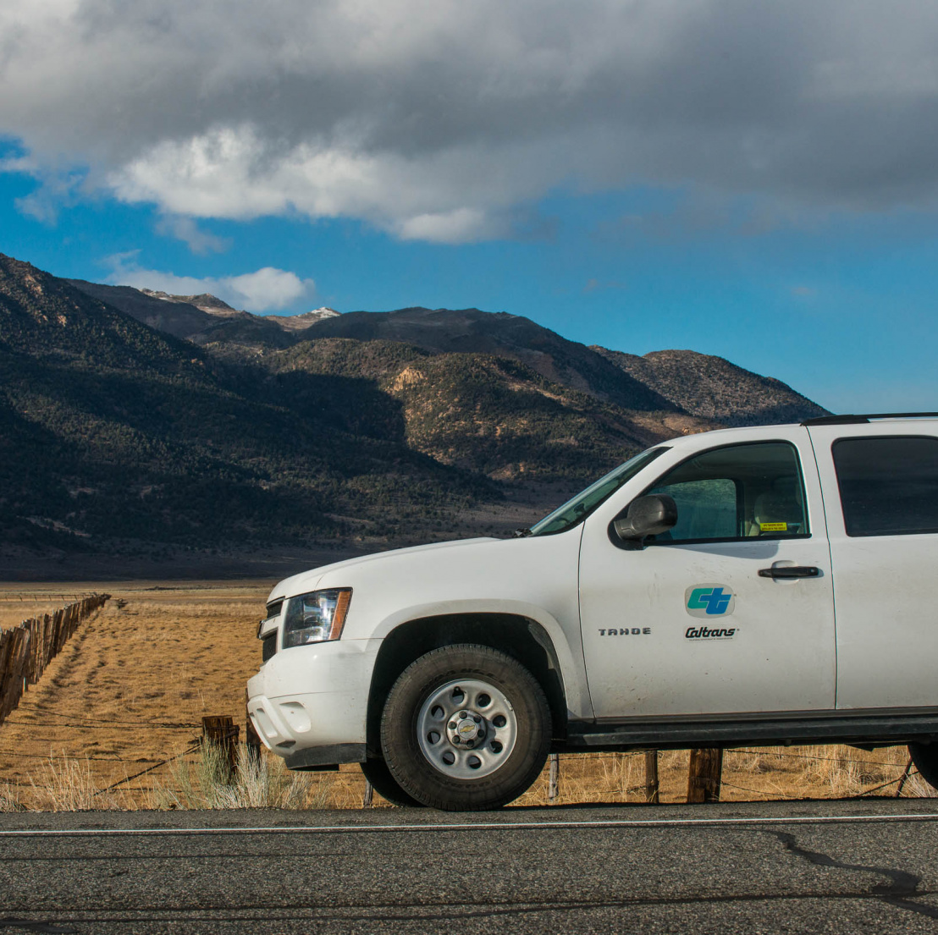
Thank you!

