Slide 1
Highway & Bridge Construction Market Update
Alison Premo Black, PhD
ARTBA Senior VP & Chief Economist
ARTBA Federal Issues Program
May 9, 2016
California Senate Presentation
Dean Franks
ARTBA
March 11, 2025

Slide 2
Presentation
Infrastructure Investment and Jobs Act so far
What’s Next

Slide 3
Infrastructure Investment & Jobs Act (IIJA)
Current federal surface transportation law
Signed by President Biden on November 15, 2021
5 years (Fiscal Years 2022-26)
Expires Sept. 30, 2026
Sets investment levels and policies for federal highway and public transportation programs
Paid for by mix of federal gas/diesel taxes and general funds
NOTE: The IIJA addresses other forms of infrastructure as well

Slide 4
Notes:
For Highways:
Core Program … $300.5 billion for reauthorization … show first year increase of 24%
Supplemental: additional $47.3 billion ($9.5 billion per year)
Formula bridge program, formula EV Charging station
Discretionary Programs ($13.1 billion)
Bridge Discretionary, Nationally Significant Freight and Highway Projects Program
Reconnecting Communities
Transit - $91.2 billion … increase from $10.2 billion to $13.4 billion
Capital Grants – up from $2.3 billion to $3 billion … increase 31 percent
Transit market has been hit very hard … going to take some time to recover

Slide 5
Formula funds include the core highway program, funds for EV charging stations and the conditions-based bridge program.

Slide 6
Increase in Federal-Aid Investment Supporting Record Market Growth
Source: FHWA final notices for annual highway program obligations and supplemental programs, Infrastructure Investment & Jobs Act

Slide 7
Annual Percentage Increase In Nominal Highway Funding
Source: FHWA, IIJA Analysis.

Slide 8
Source: Data from U.S. Treasury and the Federal Highway Administration. Project commitments are included if the base year of the award (identified in the U.S. Treasury data) . Does not include COVID relief, emergency, or supplemental funds. FY2022 totals include project commitments made using FAST Act extension funds, to provide a full year on year comparison of total projects supported by the federal aid highway program.

Slide 9
California Apportionments Under Infrastructure Investment and Jobs Act (IIJA)
Source: Data from Federal Highway Administration.

Slide 10
California
Breakdown of Federal-Aid Highway Project Value
by Type of Work Performed, FY 2022 – FY 2024
Source: Data from Federal Highway Administration from Oct. 1, 2021 to Sep. 30, 2024.

Slide 11
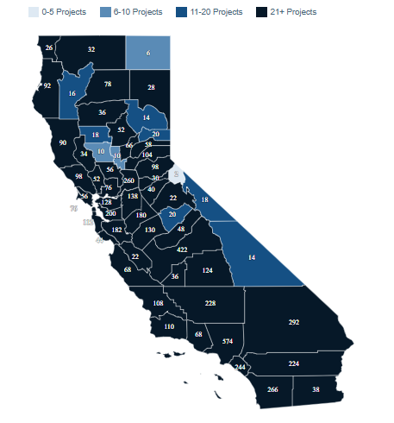
Federal-Aid Highway Projects by With Identified County,
FY 2022 – FY 2024
Does not include statewide projects
Source: Data from U.S. Treasury and the Federal Highway Administration. Project commitments are included if the base year of the award (identified in the U.S. Treasury data) . Does not include COVID relief, emergency, or supplemental funds. State map does not include projects classified as “statewide”. FY2022 totals include project commitments made using FAST Act extension funds.

Slide 12
119th Congress (2025-26)
Senate
53 Republicans
47 Democrats and Independents
House of Representatives
219 Republicans
215 Democrats
1 vacancy

Slide 13
Looking Ahead
FY 2025 Appropriations
“DOGE”
Tax/Reconciliation Package

Slide 14
Looking Ahead
2026 Surface Transportation Authorization
IIJA 2.0 or Traditional Surface Transportation Law?
Investment and Highway Trust Fund Shortfall
$250 billion needed for core surface transportation programs

Slide 15
Dean Franks (202) 834-6089 dfranks@artba.org

