Slide 1
California Climate Policies: Impacts on State Transportation Funding
Asha Weinstein Agrawal, PhD
Joint Informational Hearing
California Assembly and Senate Transportation Committees
March 3, 2025

Slide 2
Acknowledgements
Coauthors: H. A. “Burt” Tasaico
Hannah King
Funder:

Slide 3
The question:
How will ZEV mandates from the California Air Resource Board impact future state transportation revenue generated through California’s Senate Bill 1* (2017) taxes and fees?
Study method:
A scenario analysis projecting how different combinations of inputs, including different ZEV fleet shares, might impact revenue streams
*More about Senate Bill 1: https://dot.ca.gov/programs/sb1
Notes:
With scenario building, it is critical to keep in mind that the objective is very different from the objective of forecasting efforts.
Goal of the scenario analysis is to assess how our current revenue policies will fare under a variety of different
Instead, as one planning scholar put it, “Projections are conditional ‘if, then’ statements about the future. They are calculations of the numerical consequences (the ‘then’) of the underlying assumptions (the ‘if’).”
[i] Andrew M. Isserman, “Projection, Forecast, and Plan: On the Future of Population Forecasting,” APA Journal 50, no. 2 (1984), p. 208.

Slide 4
The Senate Bill 1 (2017) taxes and fees
Fuel taxes
Gasoline excise tax
Diesel excise tax
Diesel sales tax
Vehicle fees (annual)
Transportation Improvement Fee (TIF)
Road Improvement Fee (RIF)
More about Senate Bill 1: https://dot.ca.gov/programs/sb1

Slide 5
The 8 projection scenarios
The scenarios were designed to reflect a range of possible futures (not to predict what will happen)
High, medium, and low trajectories for six variable model inputs:
- State population
- Light-duty vehicles per capita
- VMT: Annual per-capita light-duty VMT*
Annual heavy-duty VMT
- ZEV %: Light-duty vehicles
Heavy-duty vehicles
* VMT = vehicle miles traveled
Notes:
Just a reminder that with scenario building, it is critical to keep in mind that the objective is very different from the objective of forecasting. While forecasting studies aim to accurately predict future outcomes, scenario studies like ours project the future under a variety of scenarios, and we don’t claim to know which, if any, will come to be.
Rather, the primary purpose of the projections is to examine how different future conditions might impact revenue streams over time.

Slide 6
High/medium/low trajectories for the variable inputs
Variable inputs |  | High | Medium | Low
State population |  | Rises by 220,000 annually | Remains constant | Declines 1% annually
Light-duty vehicles per capita |  | Rises linearly to 0.81 per capita in 2040 | Remains constant | Declines linearly to 0.61 per capita in 2040.
VMT | Annual light-duty, per capita | Rises along a sigmoid curve such that per capita VMT in 2040 is 25% higher than in 2024 | Remains constant | Declines along a sigmoid curve such that annual per capita VMT in 2040 is 25% lower than in 2024
 | Annual heavy-duty | Rises 3% annually | Rises 1% annually | Declines 2% annually
ZEV share: | Light-duty fleet | Rises along a sigmoid curve such that 99% of light-duty vehicles are ZEVs in 2040 | Rises along a sigmoid curve such that 50% of light-duty vehicles are ZEVs in 2040 | Rises along a sigmoid curve such that 20% of light-duty vehicles are ZEVs in 2040
 | Heavy-duty fleet | Rises along a sigmoid curve such that 80% of heavy-duty vehicles are ZEVs in 2040 | Rises along a sigmoid curve such that 40% of heavy-duty vehicles are ZEVs in 2040 | Rises along a sigmoid curve such that 5% of heavy-duty vehicles are ZEVs in 2040
Notes:
[Will not talk through the details on this slide, but keeping it in for reference for people who read the PPT.]

Slide 7
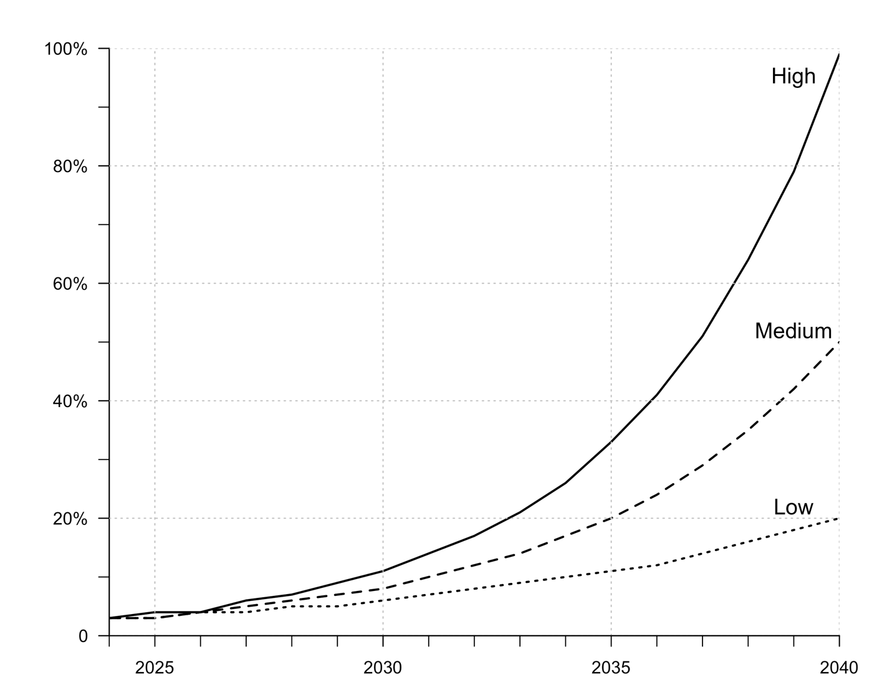
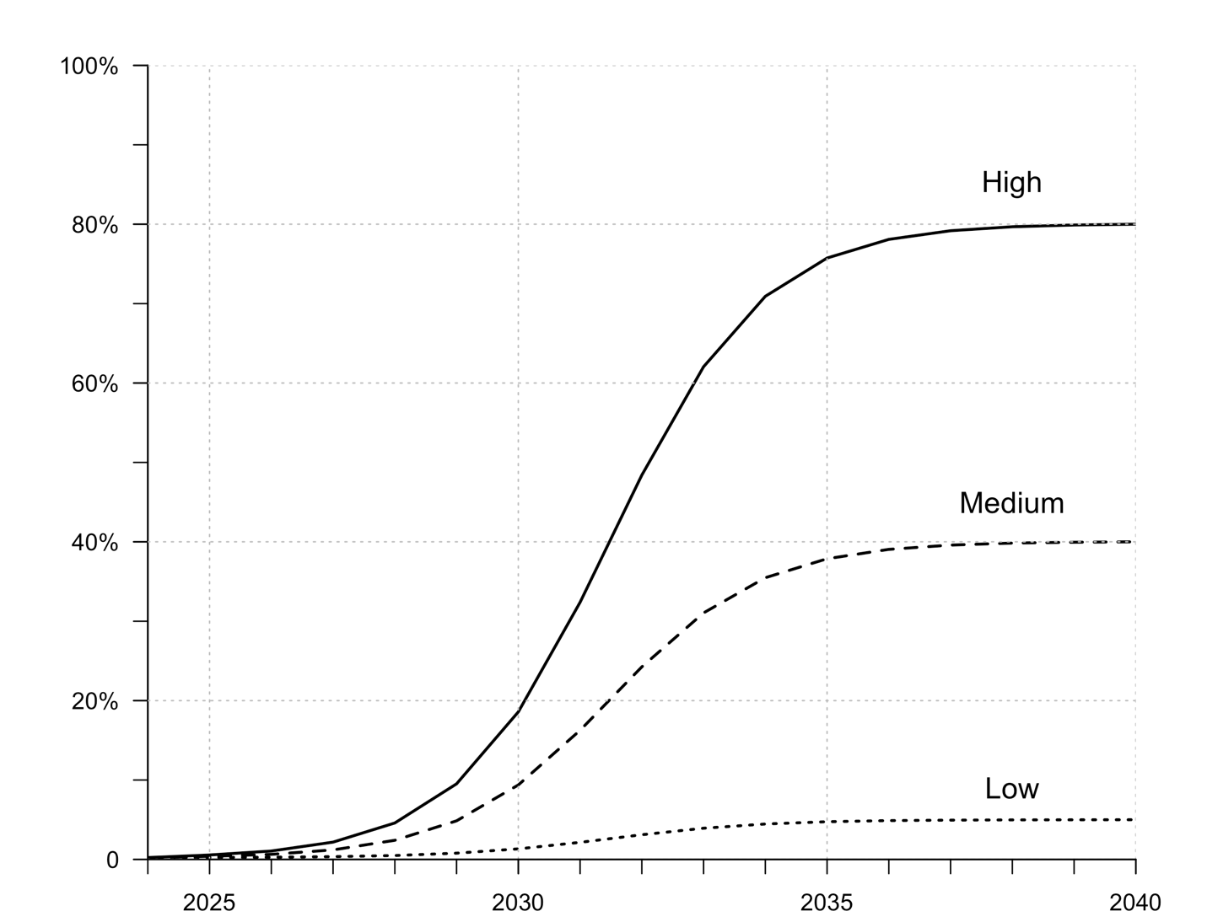
ZEV adoption trajectories (ZEV share of fleet)
Light-duty vehicles
Heavy-duty vehicles

Slide 8
Building the recovery scenarios from the variable input trajectories
 |  | LDV revenue factors |  |  |  |  | HDV revenue factors
Scenarios |  | Population | LD VMT per capita | LDVs per capita | % of LDVs that are ZEV |  | HD VMT | % of HDVs that are ZEV
Low VMT, varying ZEVs | 1. High ZEV | Low | Low | Low | High |  | Low | High
 | 2. Medium ZEV | Low | Low | Low | Medium |  | Low | Medium
 | 3. Low ZEV | Low | Low | Low | Low |  | Low | Low
Mid-range VMT, medium ZEVs | 4. Medium VMT + medium ZEV | Medium | Medium | Medium | Medium |  | Medium | Medium
 | 5. Mixed VMT + medium ZEV | High | High | Low | Medium |  | High | Medium
High VMT, varying ZEVs | 6. High ZEV | High | High | High | High |  | High | High
 | 7. Medium ZEV | High | High | High | Medium |  | High | Medium
 | 8. Low ZEV | High | High | High | Low |  | High | Low
Notes: LD = light duty; LDV = light-duty vehicle; HDV = heavy-duty vehicle; VMT = vehicle miles traveled; ZEV = zero-emission vehicle.

Slide 9
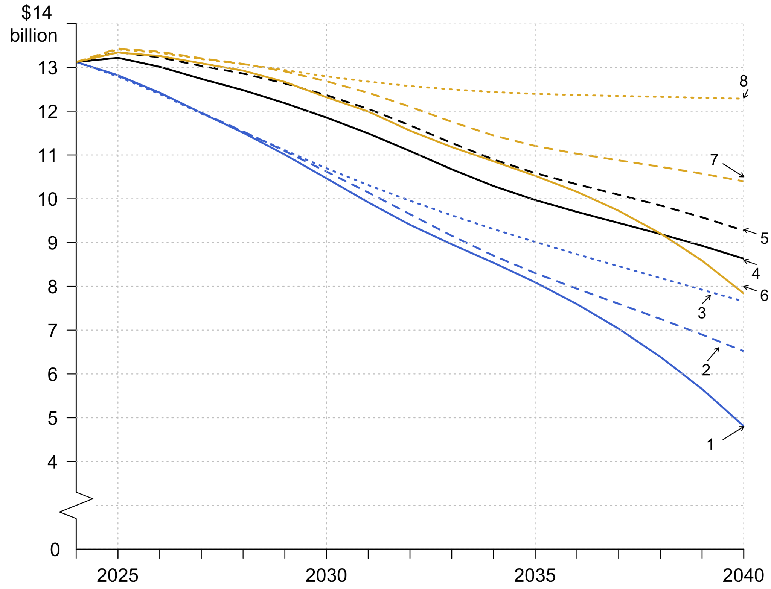
Total projected revenue, by scenario
(2024$)
Notes:
This figure presents the total revenue that California would collect from 2024 to 2040 under the eight scenarios. All projections are presented in inflation-adjusted 2024 dollars.
Estimated $13.1 billion is our starting point in 2024.
There is a decrease for all scenarios, but the slope of the decline varies enormously. If we compare 2040 to 2024 annual revenue, by 2040 we see a loss that ranges from 6% to 63%. In dollar terms, that means an annual loss in 2040 ranging from about $1 billion to $8.5 billion.
Cumulative revenue loss across all 17 years is 3% to 28% compared to what the state would have raised if we stayed at the 2024 levels. In dollar terms, that is an overall loss ranging from $7 to $64 billion.
Next, let’s think about how different ZEV shares impact revenue.
Start by comparing the two low VMT scenarios shows that have different ZEV shares. In 2040, annual revenue is $3.0 billion higher for the low-ZEV scenario (#3) than the high-ZEV scenario (#1). The difference is even larger across the three scenarios that have high VMT inputs: 2040 annual revenue in the low-ZEV scenario (#8) is $4.7 billion more than revenue in the high-ZEV scenario (#6).
However, it’s important to keep in mind that the rate of ZEV growth is not the only factor that could have a major impact on projected revenue. The models make it easier to see that VMT also has a huge impact. Let’s compare scenarios we compare the two scenarios with low ZEV but different VMT levels. By 2040 Scenario 8, which has high VMT, will raise $4.6 billion more than Scenario 3, which is the low-VMT counterpart.

Slide 10
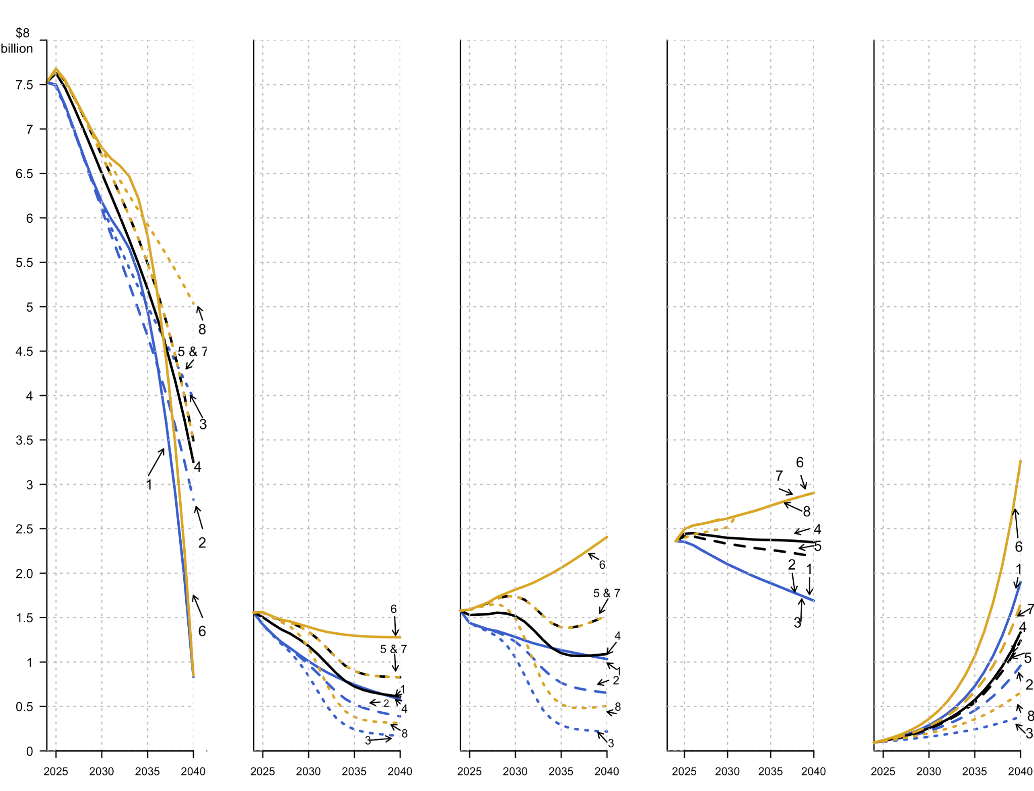
Projected revenue for each tax, by scenario (2024$)
Gas
Diesel excise
Diesel sales
TIF
RIF
Notes:
Gasoline tax revenue falls in all cases. In the most extreme case, Scenario 1, there’s a loss of $6.7 billion per year by 2040.
The two taxes on diesel fuel, the excise tax and sales tax, both fall as well. One wrinkle is that the diesel sales tax holds its value a little better than the excise tax because we assume that price grows modestly, even though fewer gallons are sold.
The RIF, the tax on light-duty ZEVs, grows in all scenarios. The TIF, assessed on all light-duty vehicles, grows in all the medium and high VMT growth scenarios. Only in the low-VMT scenarios (#1, #2, and #3) does TIF revenue fall.

Slide 11
Conclusions
It is impossible to project future revenue more than a few years into the future with any certainty
CA will likely lose significant revenue if the SB 1 taxes and fees are not changed and/or replaced in the coming few years
A fast ICE to ZEV transition will significantly reduce annual revenue – but so could other factors (e.g., VMT)
SB 1 vehicle fees partially compensate for lost fuel tax revenue
Notes:
Even in just a few years out, revenue in different scenarios varies by more than a billion dollars
By 2028, revenue will be less than 2024 by somewhere between $52 million and $1.6 billion
We point to the impact of VMT because that’s a key input we played around with in our model.
The RIF grows in all scenarios, and in some scenarios the TIF gros as well.

Slide 12
Policy suggestions: updating state tax policy
Explore a wide variety of tax/fee options to replace or augment state fuel taxes
Consider replicating the SB 1 approach: a package of taxes/fees charged against different activities (VMT, vehicles owned)
Work towards implementing a new approach for replacing lost fuel tax revenues within a few years

Slide 13
Policy suggestions: future projections studies
Ensure that projections make transparent all inputs and assumptions
Project multiple scenarios
Project additional taxes and fees that generate substantial revenue for transportation in CA (e.g., truck weight fees and local-option sales taxes)
Update revenue projections frequently to reflect changing conditions (annually or semi-annually)

Slide 14
Resources from MTI
Projecting State Transportation Revenue in California
MTI Annual Survey of US Public Opinion on Federal Transportation Funding Policy
Pay-As-You-Go Driving: Examining Possible Road-User Charge Rate Structures for California
Understanding COVID-19’s Impact on Local Transportation Revenue - A Mid-Crisis View from Experts
Charging Drivers by the Gallon vs. the Mile: An Equity Analysis by Geography and Income in California
How Do California’s Local Governments Fund Transportation? A Guide to Revenue Sources
The MTI Mileage Fee Research and Information Directory (MFRID)
Author contact: Asha Weinstein Agrawal, PhD

