Slide 1
Senate Transportation Committee Oversight Hearing on HSRA 2023 PUR
Stacey Mortensen, Executive Director – SJRRC/SJJPA

Slide 2
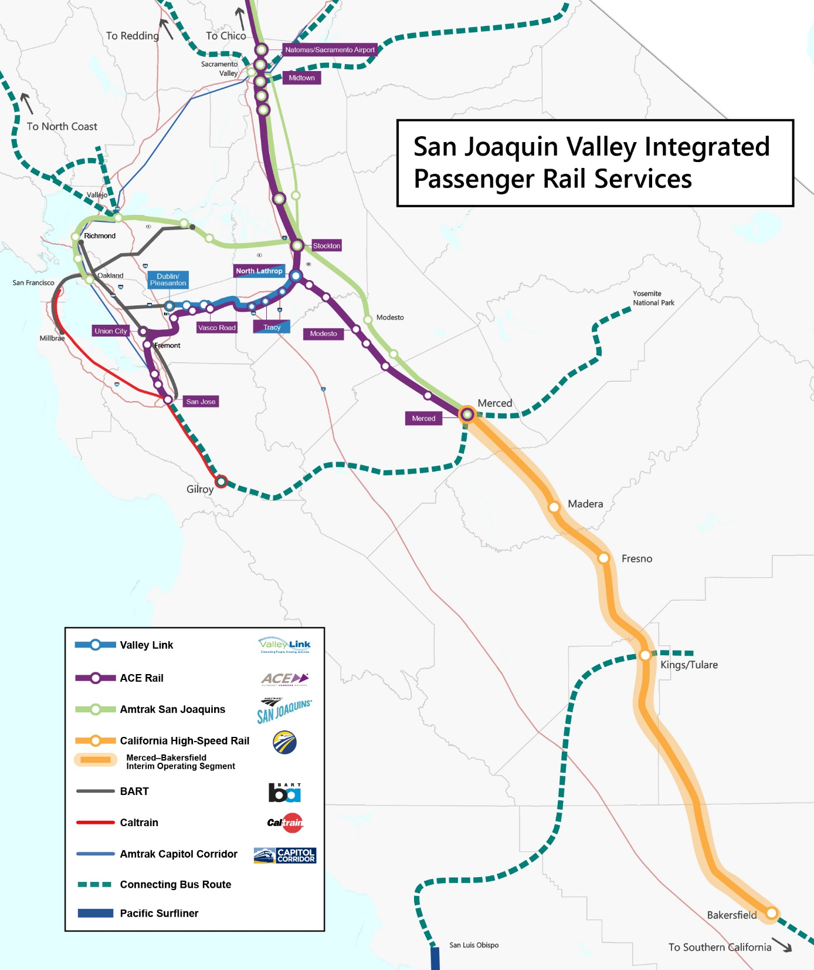

Slide 3
Valley Rail Program
Valley Rail Program is a phased passenger rail expansion from Merced to the South Bay, East Bay and Sacramento
The expansion is phased to add progressively more service on both Union Pacific and Burlington-Northern/Santa Fe freight rail lines to ultimately meet the trains on the Initial Operating Segment of HSR
The expansion involves the Mega projects for the Stockton Diamond Flyover and the Merced Integrated Track Connection
The nearly $2 Billion program involves complex projects within and adjacent to the operating freight rail lines which have to maintain full goods movement during construction

Slide 4
Stockton Diamond Flyover

Slide 5
Challenges/Positives
Challenges:
Construction costs have skyrocketed due to delays in material availability and price volatility
Freight railroads and utility carriers have finite resources to review and approve project engineering and construction
Positives:
Intercity Rail ridership has almost returned to pre-Covid levels
Building stations for the future
No need to tear up track or roads again
Full accessibility for all passenger mobility levels
Accommodates all future passenger and freight train scenarios

Slide 6
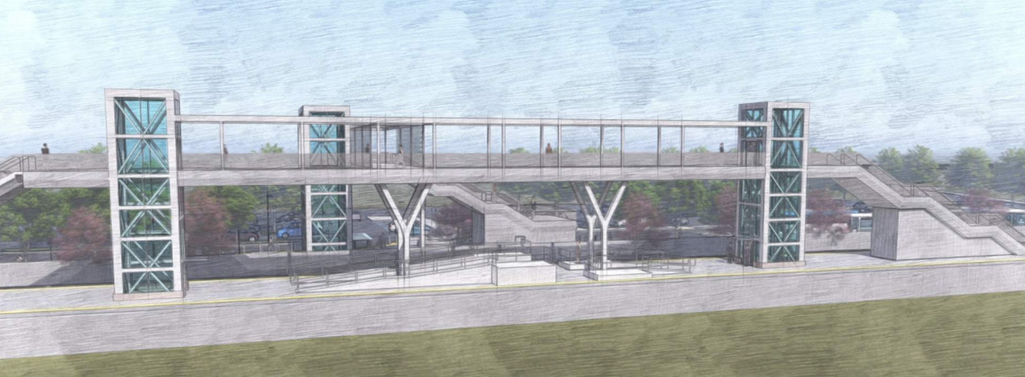
Accessibility

Slide 7
Existing ACE and San Joaquins
ACE
4 Round-Trips
Monday – Friday
San Joaquins
7 Round-Trips
5 – Bakersfield and Oakland
2 – Bakersfield and Sacramento
7 days a week

Slide 8
End of 2026
New Stations Opening:
Natomas
Midtown
Elk Grove
Downtown Manteca
Modesto
Ceres
Madera
Oakley
1 New ACE Round-Trip Ceres to San Jose
1 Existing ACE Round-Trip Extended to Natomas
Manteca, Midtown, and Madera will be ready in 2025, but due to endpoint layover needs, service will begin in late 2026 when Natomas and Ceres are completed.

Slide 9
End of 2027
New Stations Opening:
North Lathrop Transfer Station
Lodi
Ripon
Stockton Diamond Grade Separation Completed
2 New ACE Round-Trips Ceres to Natomas with ability to transfer to/from San Jose at North Lathrop Transfer Station
1 New intercity Round-Trip Stockton to/from Natomas
Assumes funding is secured for Tuolumne and Stanislaus River Bridges

Slide 10
2029
New Stations Opening:
Old North Sacramento*
City College
Turlock
1 New San Joaquins Round-Trip Fresno to/from Natomas
1 New San Joaquins Round-Trip Stockton to/from Natomas
Ceres – Turlock Extension
*Subject to City of Sacramento Redevelopment Study

Slide 11
High-Speed Rail Planning Horizon
2030-2033
New Stations Opening:
Livingston
Atwater*
Merced (new)
Extensions Opening:
Union City
North Valley Extension
Service optimized to meet HSR.
*Subject to Local Funding

