Slide 1
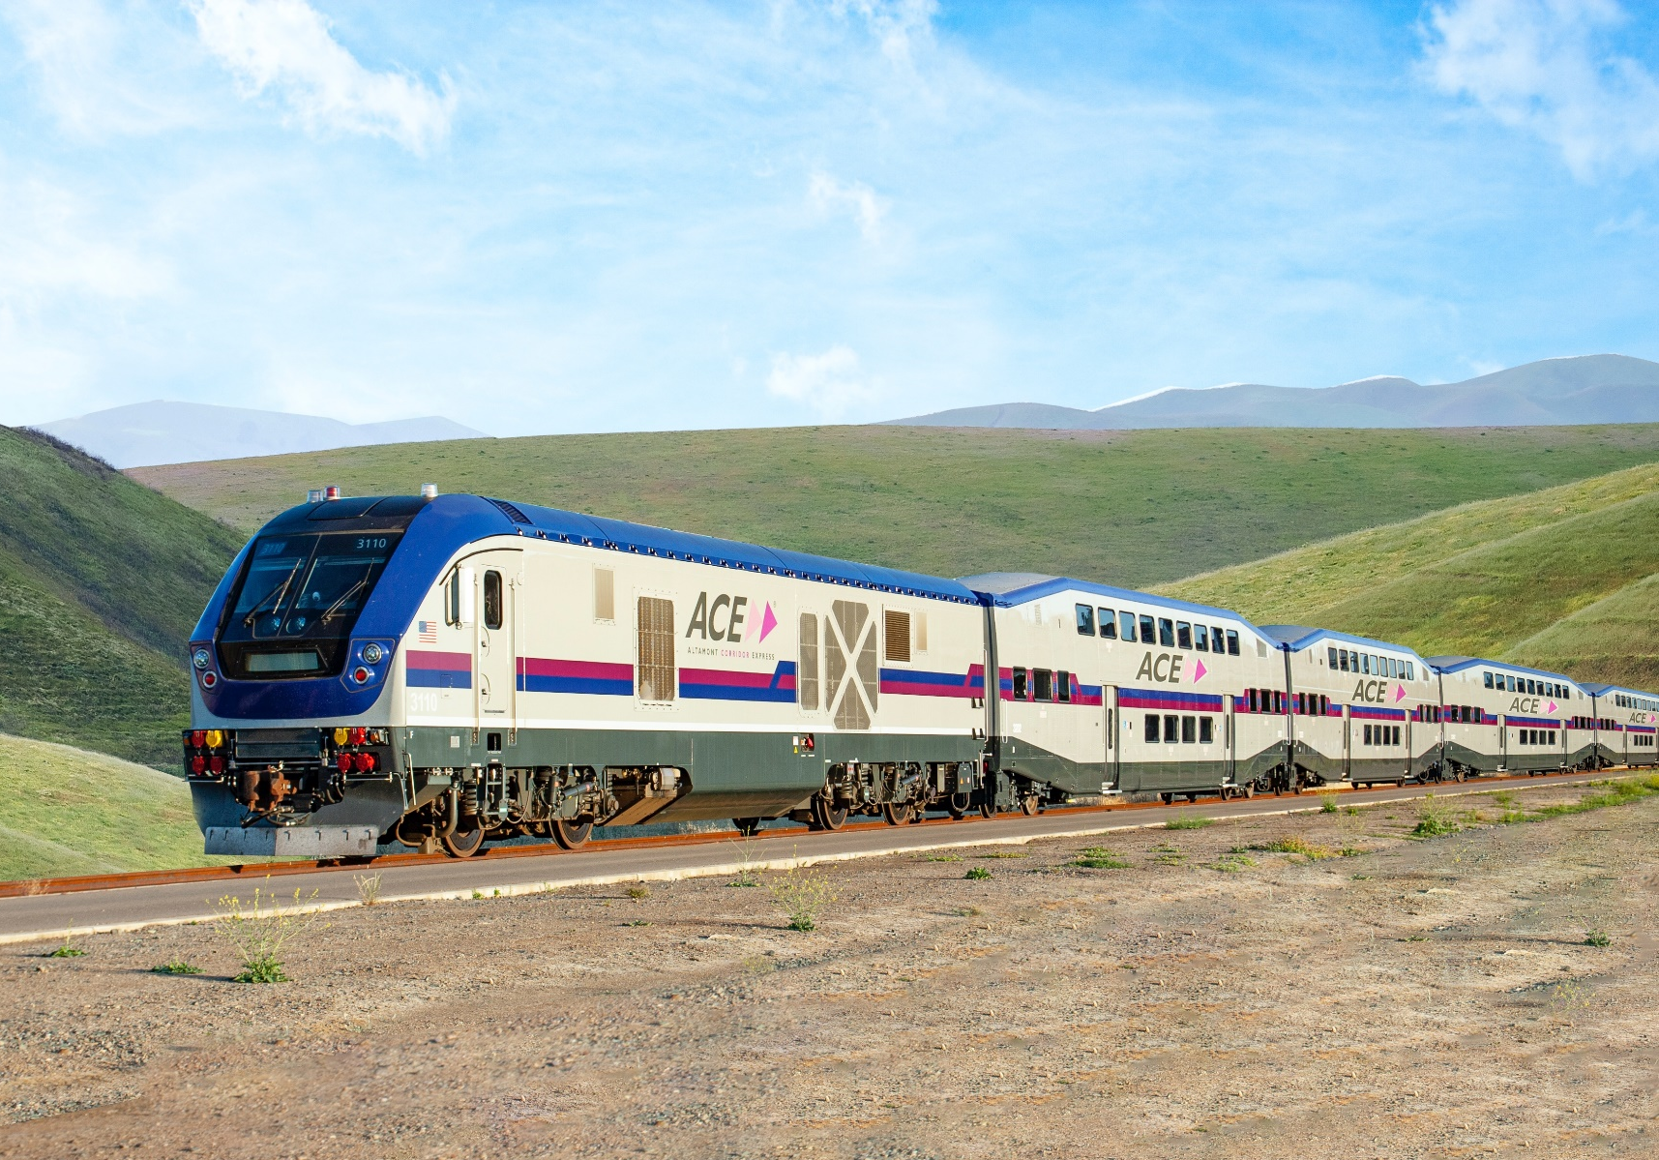
Senate Hearing on CA High Speed Rail Business Plan Stacey Mortensen, Executive Director San Joaquin Regional Rail Commission March 2022

Slide 2
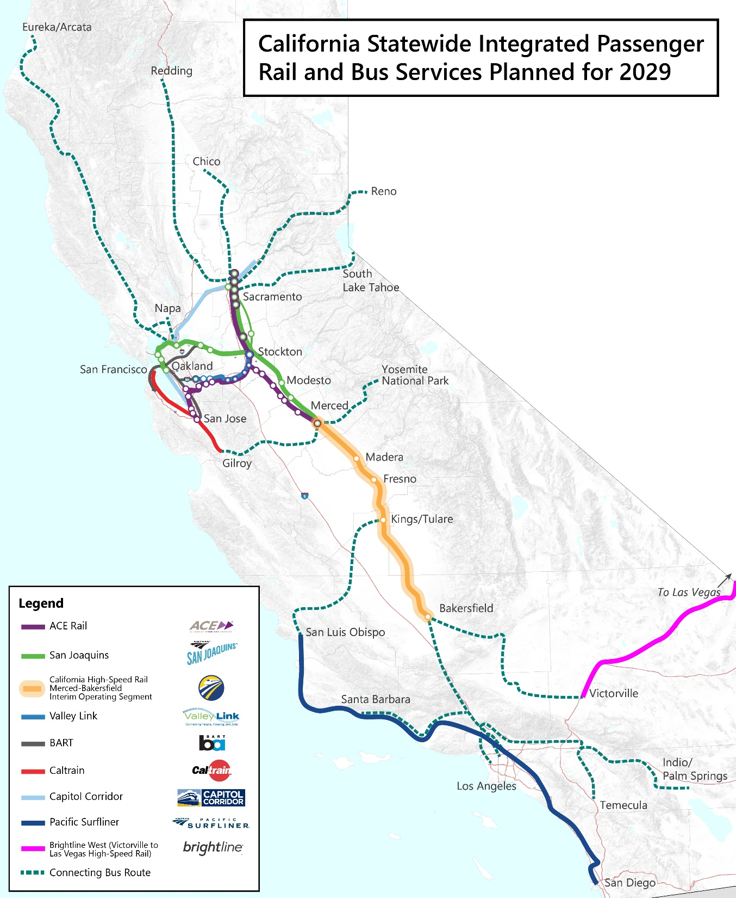

Slide 3
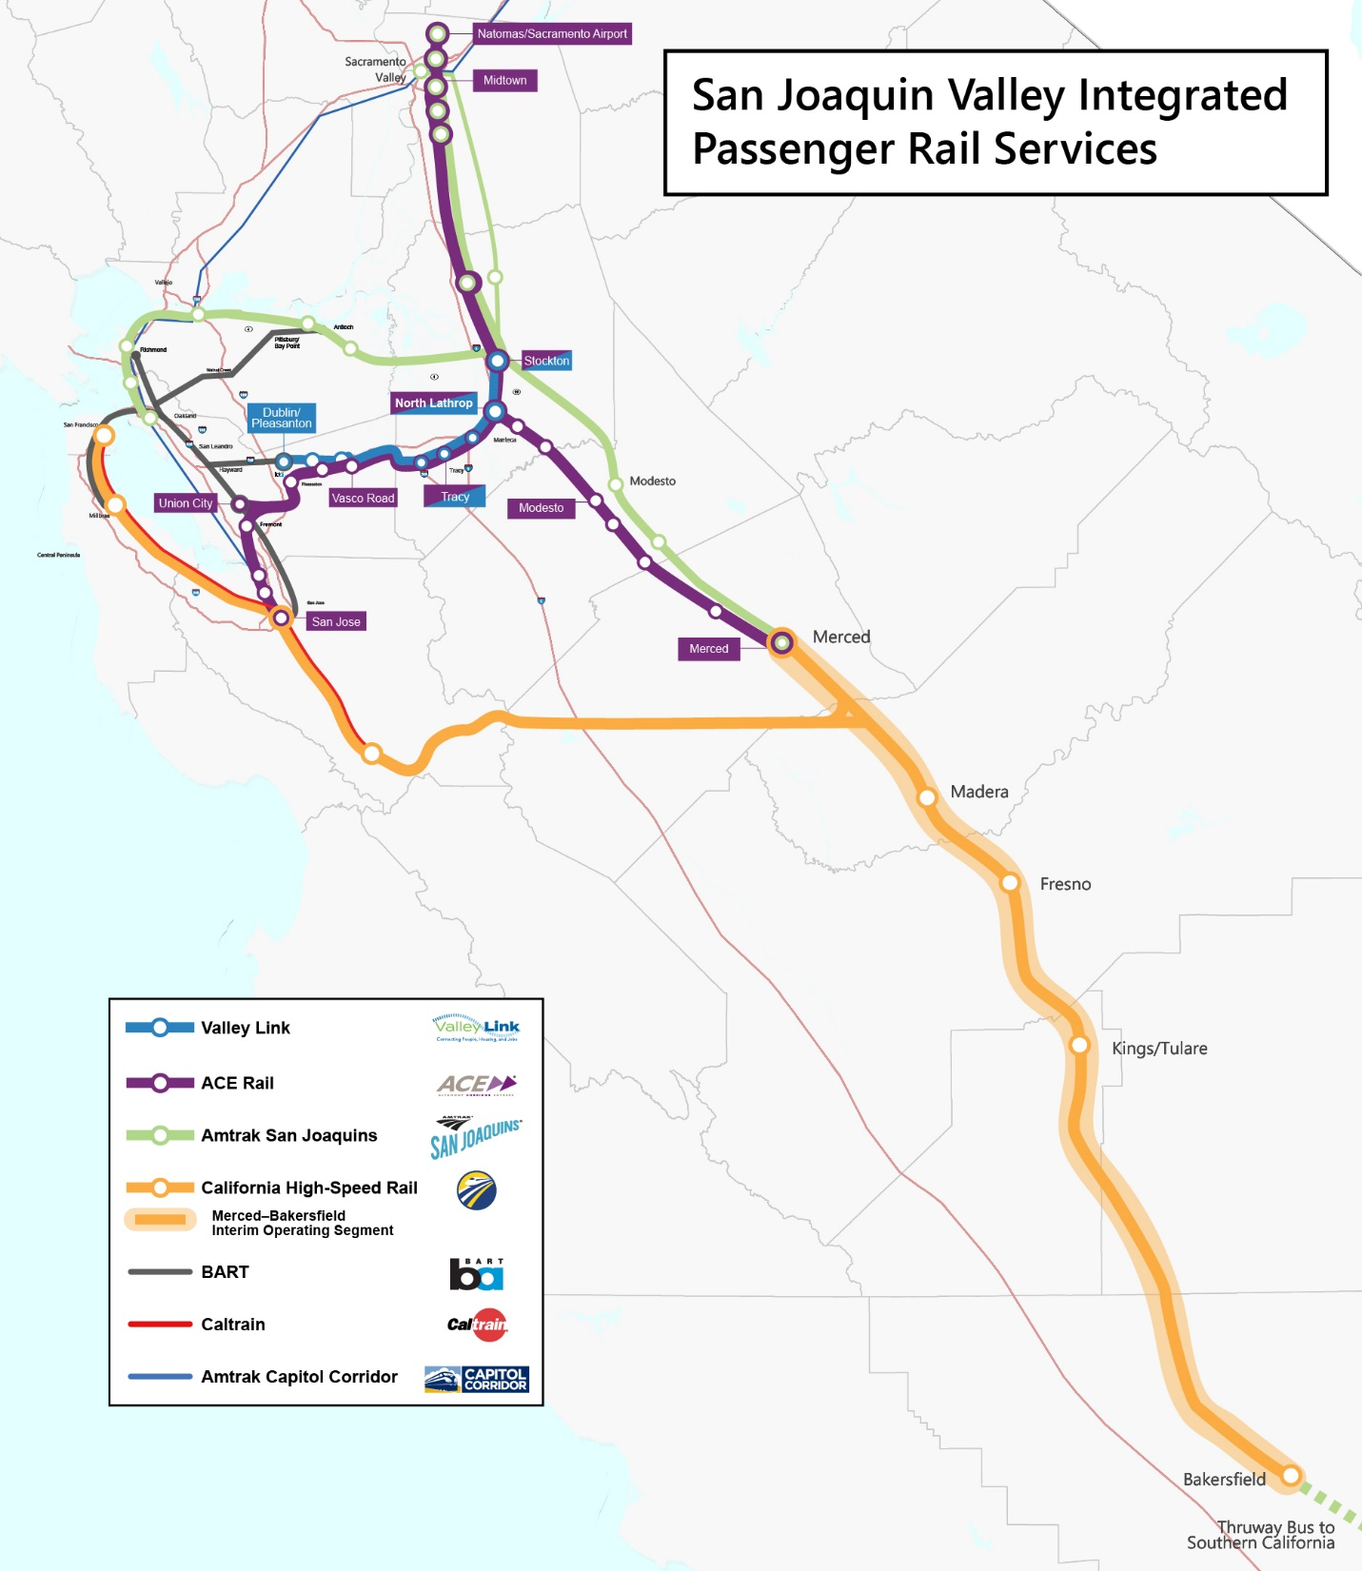

Slide 4
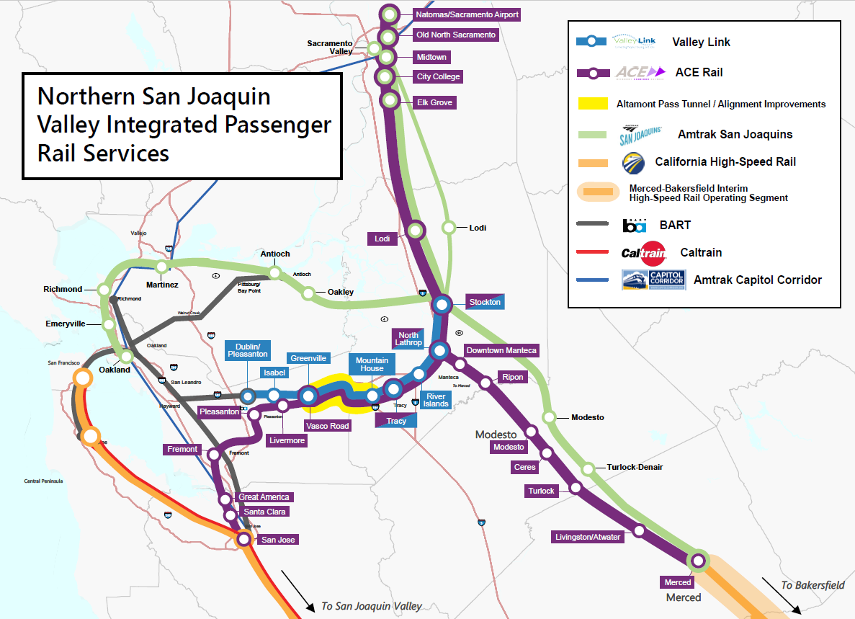

Slide 5
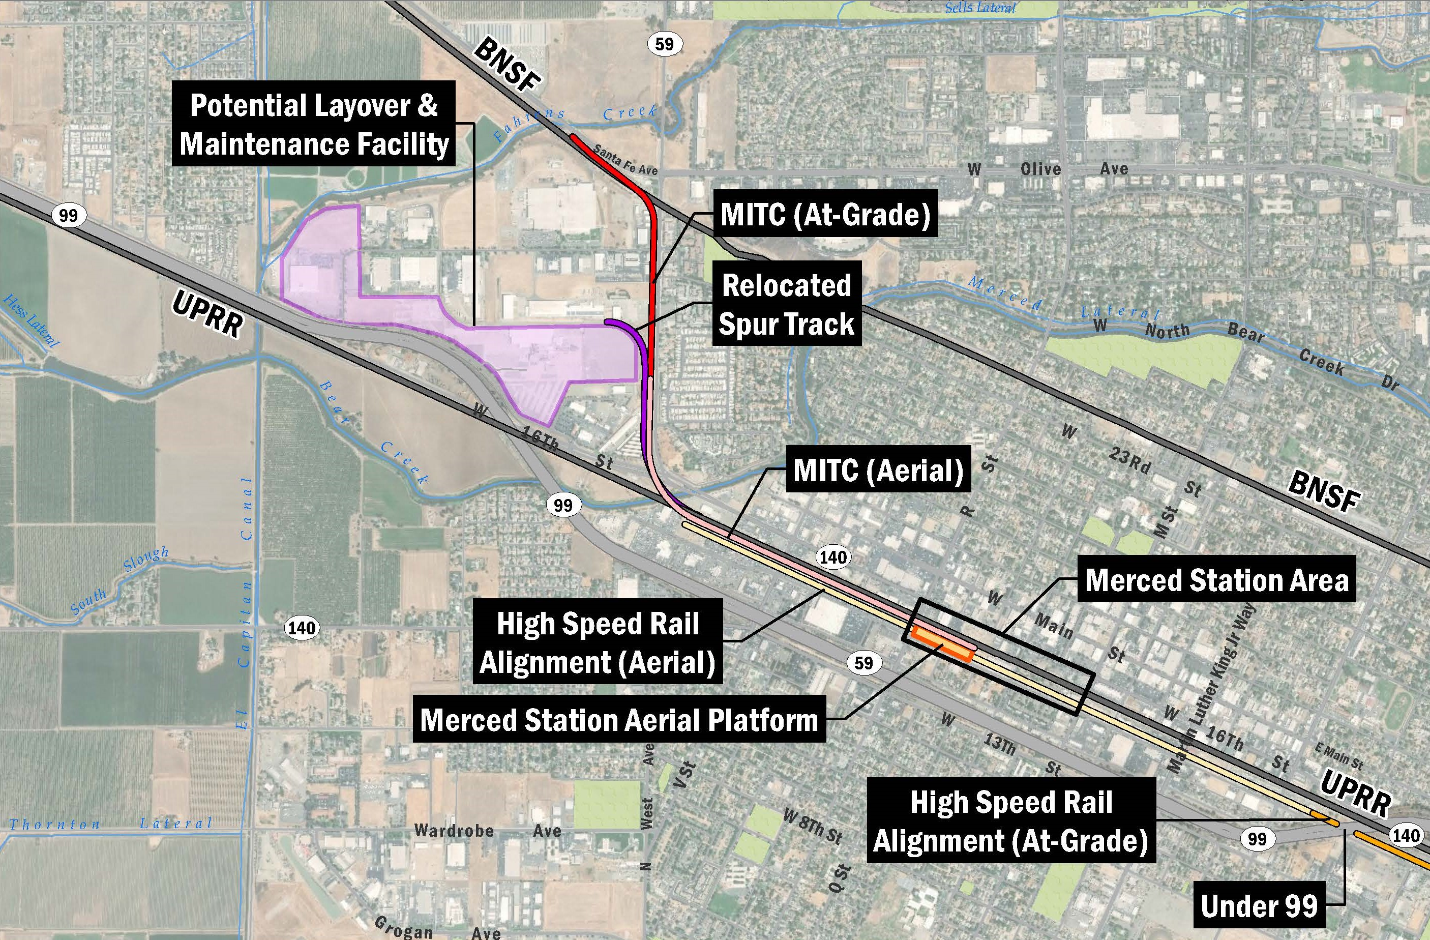
MITC Alignment

Slide 6
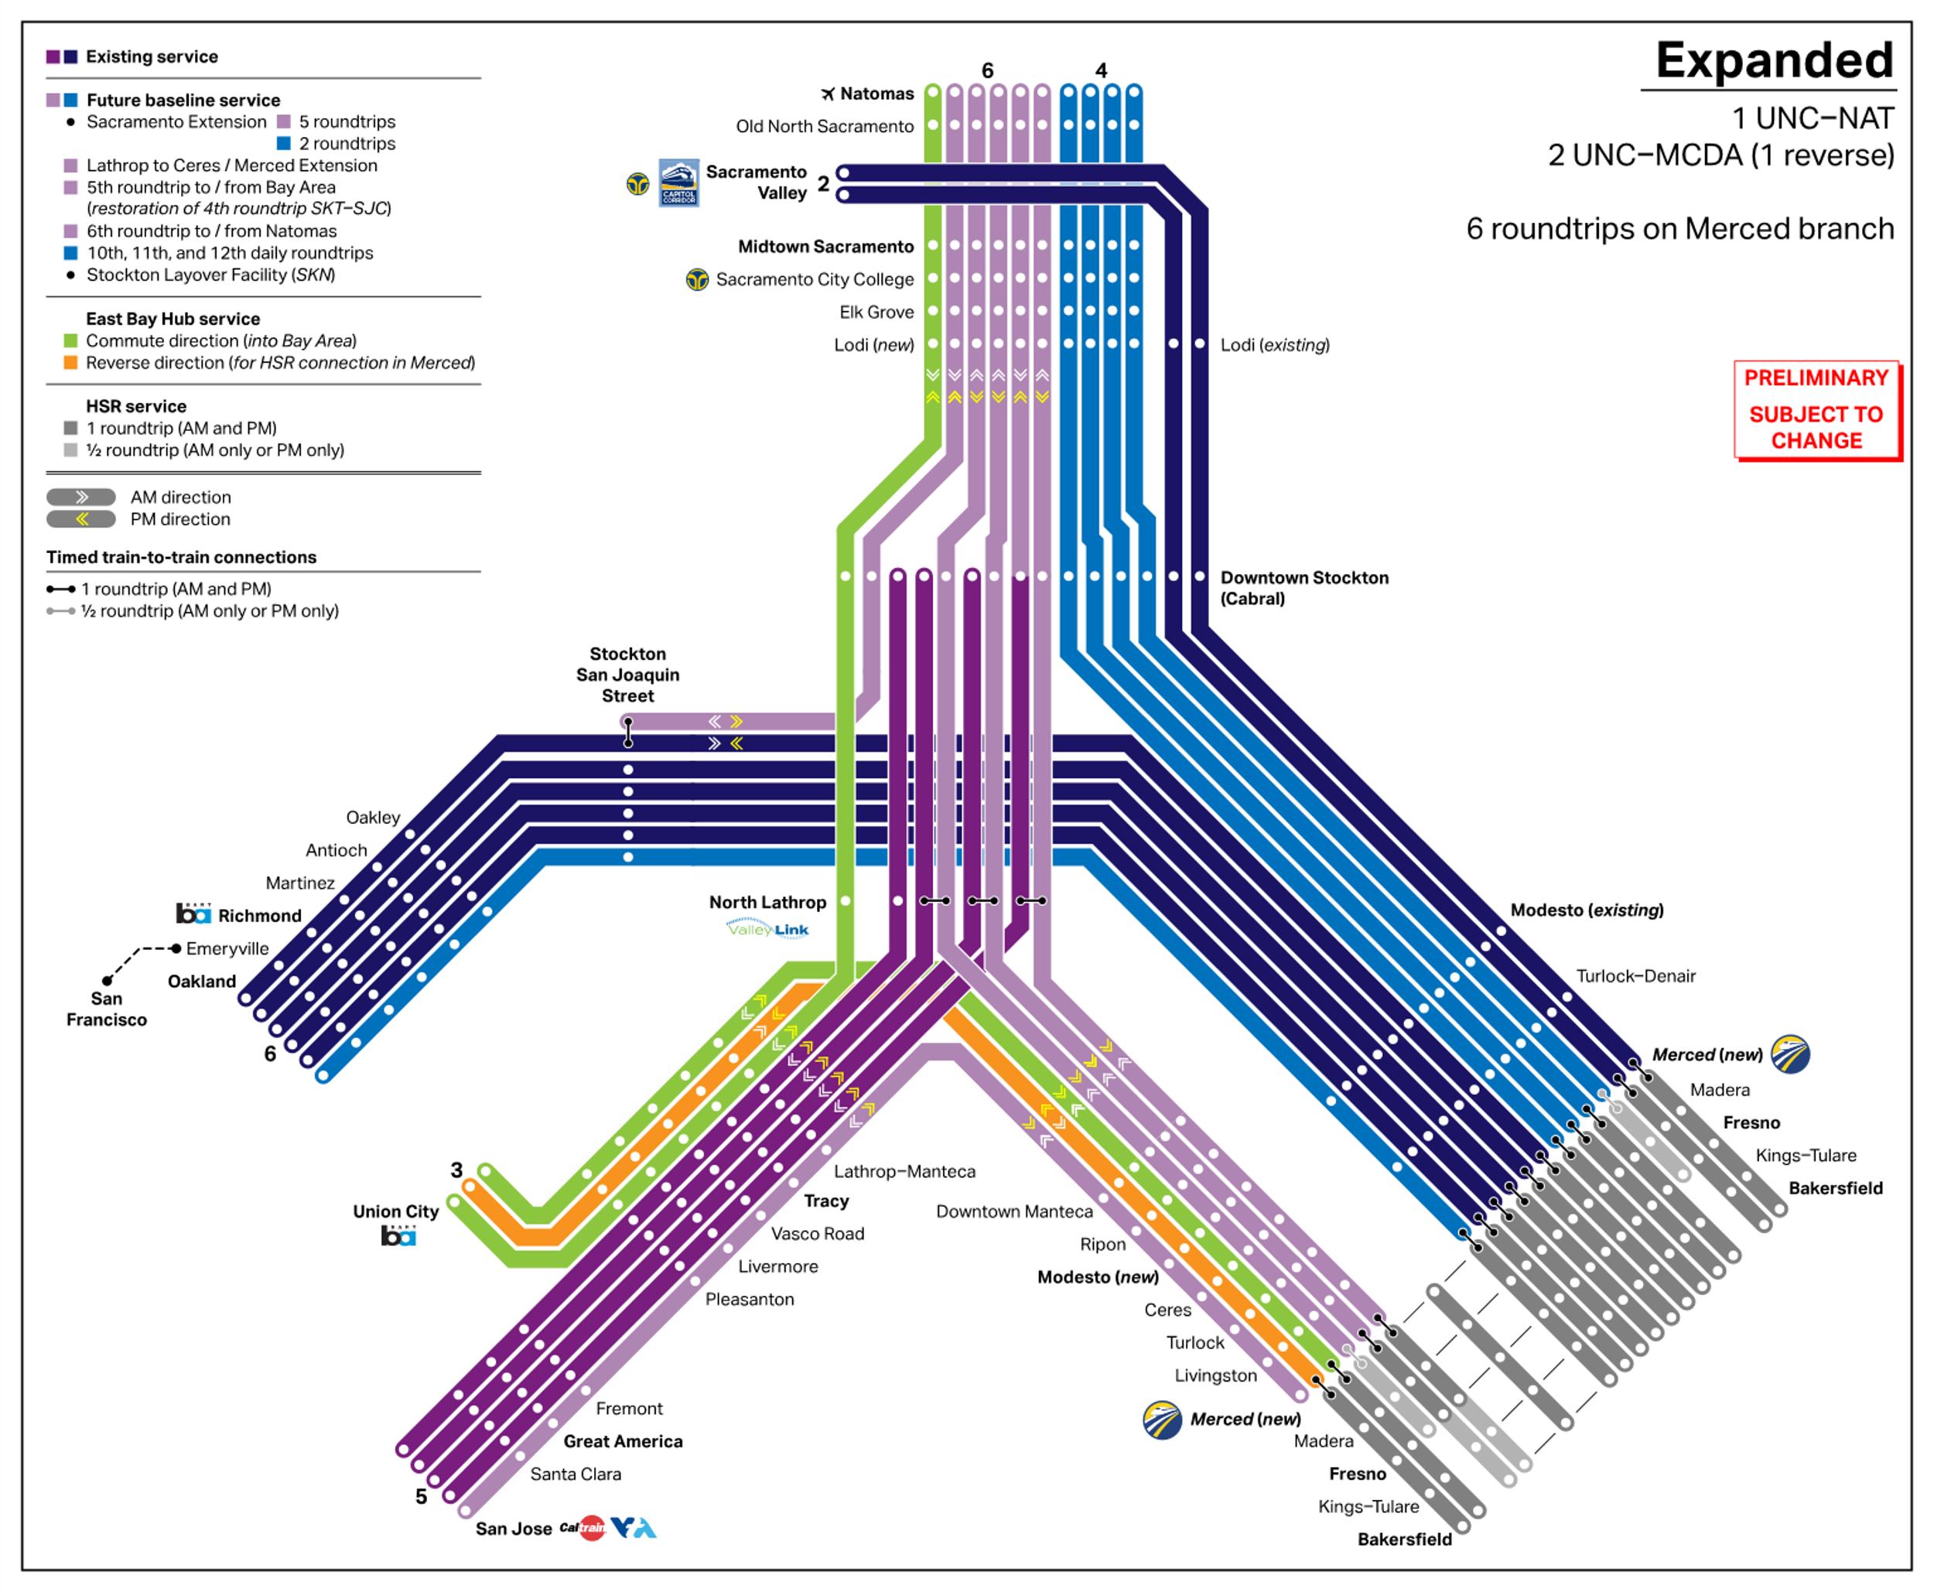
Valley Rail:
Mid-term Connectivity

Slide 7
Thank You and Always Be Safe Around Trains!
stacey@acerail.com

