Slide 1
2022 draft Business Plan
Brian Kelly
Chief Executive Officer
March 8, 2022
Notes:
Title slide – add name and title or presenter(s), and event information

Slide 2
Draft 2022 business plan
Current & Proposed Program Capital Cost Summary
Cost Category | Cost Estimate*
Current Program Budget / December 2021 Board Authorization: Central Valley Segment Construction Track and Systems (single-track) Statewide Environmental Clearance Regional Bookend Projects (Northern and Southern California) Advance Design: Merced/Bakersfield Extensions and Central Valley Stations Program wide support | 17, 937
Proposed Future Elements for Merced to Bakersfield Interim High-Speed Service Trainsets for testing and Interim Operations (6 trainsets) Construction of Merced and Bakersfield Extensions (single-track) Construction of second track from Merced to Bakersfield (built concurrently) Construction of Central Valley Stations | 4,566 - 6,009
Subtotal | 22,503 - 23,946
Northern California Advance Design | 213
Southern California Advance Design | 382
Total | 23,099 - 24,542
*$ in Millions YOE

Slide 3
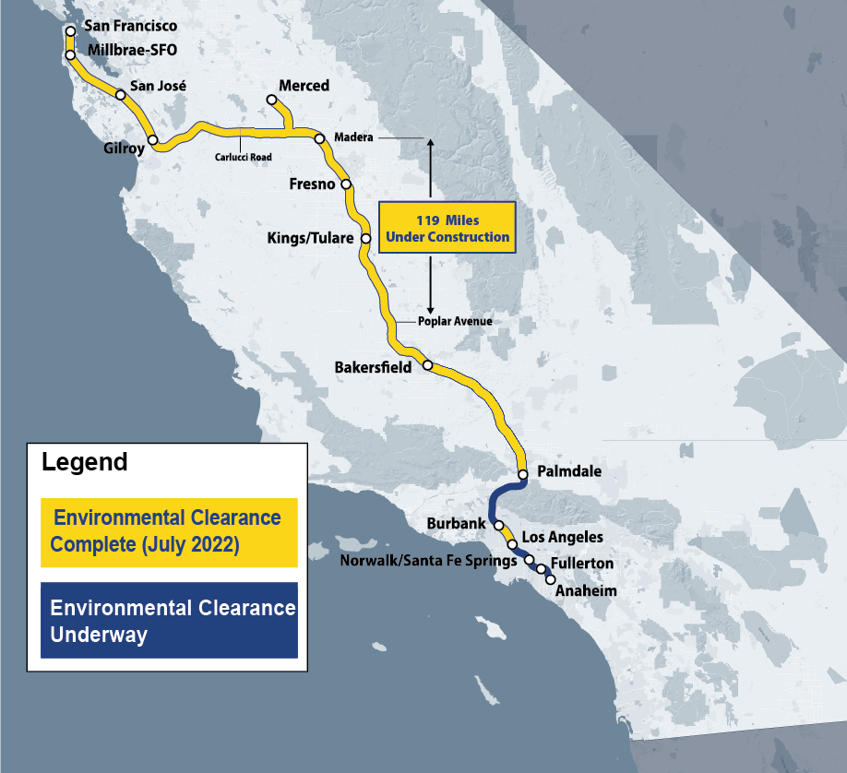
Draft 2022 business plan
Transformative Transportation Project

Slide 4
Draft 2022 business plan
Full Phase 1 Program Cost Estimate ($ in Millions YOE)
Evaluation Criteria | Central Valley Corridor
Corridor Statistics
Length of Corridor (in miles) | 171
Highest Speed Attainable (in mph) | 220
Service Results
Ridership Increase (in millions) | 4.8
Revenue Increase ($ in millions) | 117.2
Additional Annual Passenger Miles Traveled (in millions) | 340
Congestion Relief
Annual Vehicle Miles Traveled Reduction (in millions of miles) | 283.6
Annual Vehicle Reduction (in thousands)** | 21.0
Air Quality Benefits
Greenhouse Gas Emissions Reduction (in thousands of metric tons of CO₂) | 50.6
Schedule Horizon
High-Speed Rail Operation Within 10 Years | Yes

Slide 5
Draft 2022 business plan
INFRASTRUCTURE INVESTMENT AND JOBS ACT
Competitive Grant Programs
Program | Eligibility / Purpose | Appropriated | Additional Authorized | Total
Federal-State Partnership for Intercity Passenger Rail (excluding NE Corridor amount) | High-Speed Rail and all intercity rail expansion projects Multi-year commitments possible | $12 Billion | $4.1 Billion | $16.1 Billion
Consolidated Rail Infrastructure and Safety Improvements (CRISI) | Capital projects that will improve passenger and freight rail transportation systems in terms of safety, efficiency, or reliability | $5 Billion | $5 Billion | $10 Billion
National Infrastructure Project Assistance (Mega Projects) | Broad eligibility for different types of infrastructure | $5 Billion | $10 Billion | $15 Billion
Local and Regional Project Assistance (NIPA – also known as RAISE) | Invest in road, rail , transit and port projects that promise to achieve national objectives | $7.5 Billion | $7.5 Billion | $15 Billion
Nationally Significant Multimodal Freight and Highway Projects (also known as INFRA) | Fund highway and freight projects of national and regional significance Available for rail/highway crossing projects. | $3.2 Billion | $6.0 Billion (Authorized) $4.8 Billion (Contract Authority) | $14 Billion
Federal Railroad Administration Railroad Crossing Elimination | Highway-rail grade crossing improvement projects that focus on improving the safety and mobility of people and goods. | $3 Billion | $2.5 Billion | $5.5 Billion
Key to Terms: Appropriated – Funds are appropriated in the legislation Authorized – Funds can only be released upon future appropriation by Congress Contract Authority – Funds come from the Highway Trust Fund and do not require appropriations to be released

Slide 6
Draft 2022 business plan
Full Phase 1 Program Cost Estimate ($ in Millions YOE)
Segment | Low | Base | High
Merced To Bakersfield Line
Interim Program Baseline, Expenditure Authorization | — | 17,937 | —
Trainsets (2 each) | — | 390 | —
Merced and Bakersfield Extensions (Single Track, 4 stations)* | — | 3,071 to 4,514 | —
Merced to Bakersfield (Second Track) | — | 1,106 | —
Northern California
San Francisco to San José | 1,307 | 1,649 | 2,123
San José to Gilroy | 2,162 | 3,194 | 4,633
Gilroy to Carlucci Road (connection to Central Valley) | 7,871 | 10,397 | 12,789
Central Valley Wye Balance | 1,842 | 2,240 | 2,601
Advance Design Costs | — | 213 | —
Southern California
Bakersfield to Palmdale | 14,703 | 18,379 | 22,239
Palmdale to Burbank | 12,635 | 16,775 | 24,428
Burbank to Los Angeles | 2,201 | 2,935 | 3,405
Los Angeles to Anaheim | 2,478 | 2,918 | 3,352
Advance Design Costs | — | 382 | —
Other System Costs
Heavy Maintenance Facility Balance | 433 | 481 | 529
Trainset Balance | 4,161 | 4,643 | 5,084
Phase 1 Cost Range | 72,297 | 86,710 – 88,153 | 105,129

Slide 7
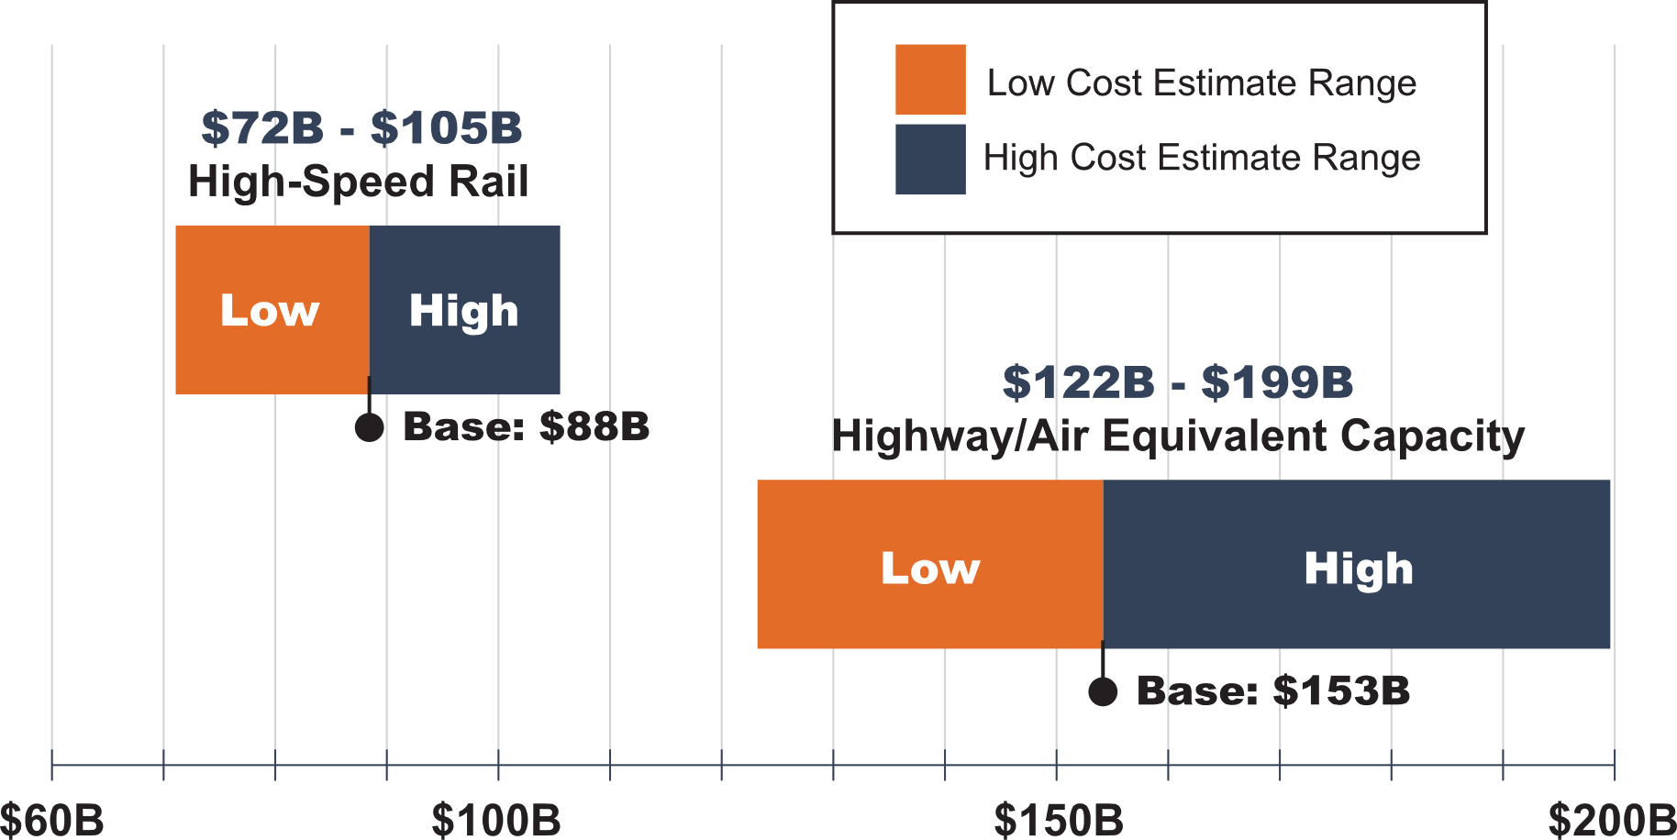
Draft 2022 business plan
COST BENEFIT COMPARISON

Slide 8
Draft 2022 business plan
PUBLIC COMMENT OPPORTUNITIES
Schedule / Board Meetings
February 8 Draft Business Plan out for 60-day public review
February 17 Board Meeting
March 17 Board Meeting
April 11 End of 60-day public comment
April 20-21 Board Meeting – Action/direction on preparing final plan
May 1 Final 2022 Business Plan due to Legislature

