Slide 1
Joint informational hearing Senate Transportation Committee & Senate Budget Sub-committee #2
Lenny Mendonca, CHSRA Board Chairman
Brian Annis, Secretary, California Transportation Agency
March 26, 2019

Slide 2
Senate joint informational hearing California high-speed rail authority
Credibility:
The quality of being believable and worthy of trust.

Slide 3
Senate joint informational hearing California high-speed rail authority
Re-establishing Credibility through:
Transparency
Keeping Our Commitments
Delivering High-Speed Rail trains while ‘living within our means’

Slide 4
Senate joint informational hearing California high-speed rail authority
Governor Newsom is for delivering high-speed rail for Californians in a way that is:
Transparent
Responsible
Realistic
Accountable

Slide 5
Senate joint informational hearing California high-speed rail authority
“High-speed rail is much more than a train project. It’s about economic transformation and unlocking the enormous potential of the Valley.”
- Governor Newsom

Slide 6
Senate joint informational hearing California high-speed rail authority
TRANSPARENCY – BOARD OF DIRECTORS
Board of Director’s Finance and Audit Committee
Public Meetings
Reviews and monitors project status, trends, challenges and opportunities in public forum
Committee documents/monthly reports are available online today

Slide 7
Senate joint informational hearing California high-speed rail authority
TRANSPARENCY – 2018 BUSINESS PLAN
First plan to assign dollars and time to risks
First plan that used ranges to estimate costs
Recognized funding constraints and introduced the idea of delivering the project in “building blocks,” like most major infrastructure projects are delivered

Slide 8
Senate joint informational hearing California high-speed rail authority
TRANSPARENCY – 2018 BUSINESS PLAN
Set the following priorities:
Meet our commitments to the federal government
Complete Central Valley Segment
Complete Environmental Reviews Systemwide
Add Central Valley Track and Systems
Extend Central Valley Segment from orchard into downtown Bakersfield

Slide 9
Senate joint informational hearing California high-speed rail authority
TRANSPARENCY – 2018 BUSINESS PLAN
Set the following priorities
Explore and Report Options for Early Interim Service in the 2019 Project Update Report (PUR)
Subject cost estimates to further review and risk analysis and report in the PUR
Invest Remaining “Bookend” Funds
Pursue additional funding or financing to complete full system

Slide 10
Senate joint informational hearing California high-speed rail authority
TRANSPARENCY – NEW MEASURES
Governor Newsom: Make project change orders available to the public online.
Status: 338 change orders now available on our “Transparency and Accountability” page at the Authority’s website.
State Auditor: Provide quarterly reporting to the Legislature on our progress toward meeting our federal Funding Agreement requirements.
Status: First report provided January 30, 2019, the next one due on April 30, 2019.
10

Slide 11
Senate joint informational hearing California high-speed rail authority
“We will continue our regional projects in the north and south.”
- Governor Newsom

Slide 12
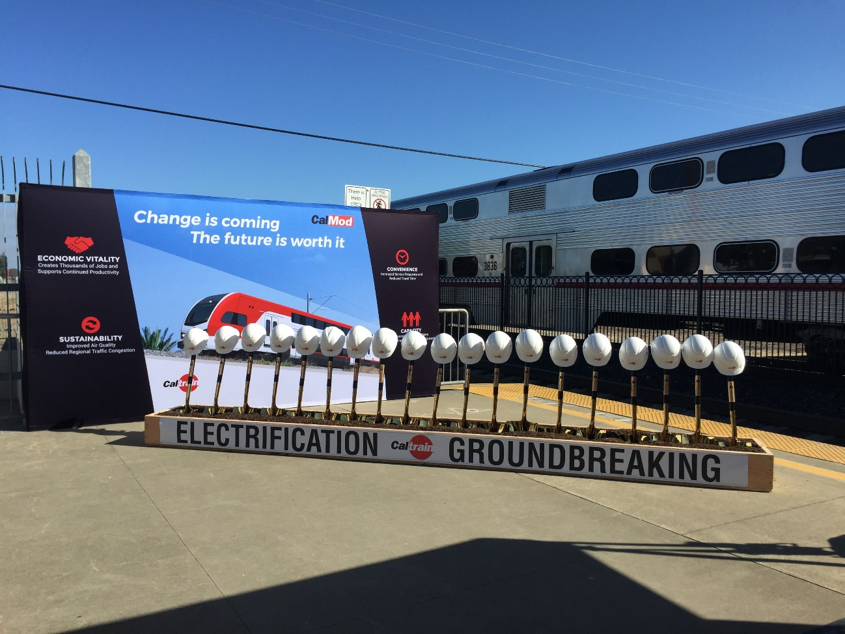
Senate joint informational hearing California high-speed rail authority
KEEPING OUR COMMITMENTS
Northern California:
Caltrain Electrification - $600m bond funds plus $113m in Cap and Trade funds

Slide 13
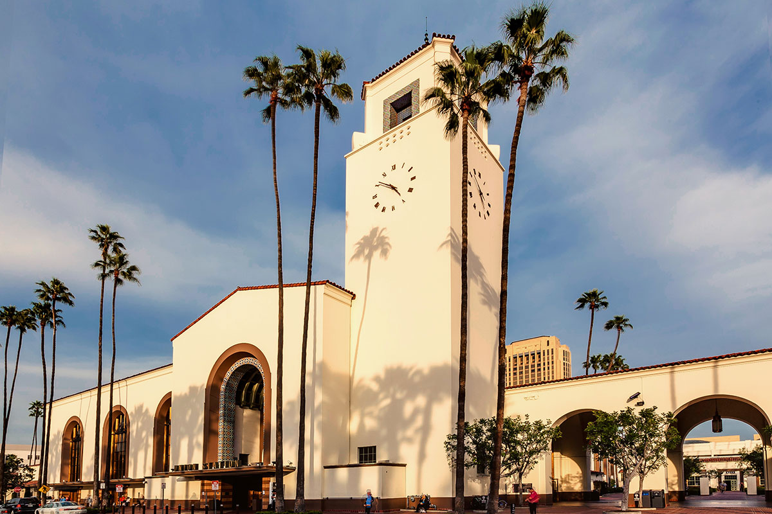
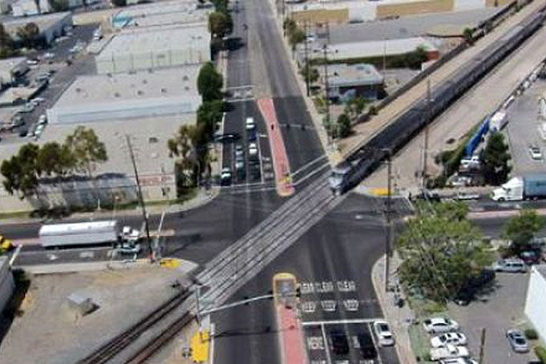
Senate joint informational hearing California high-speed rail authority
KEEPING OUR COMMITMENTS
Southern California:
LA Union Station improvements ($423m)
Rosecrans/Marquardt Grade Separation ($77m)

Slide 14
Senate joint informational hearing California high-speed rail authority
KEEPING OUR COMMITMENTS
“We will finish Phase 1 (San Francisco – Los Angeles /Anaheim) environmental work.” – Governor Newsom
Progressing all environmental work
Requested streamlining authority from federal government
Environmental work is on schedule to be completed by the required date in the federal funding agreement (2022)

Slide 15
Senate joint informational hearing California high-speed rail authority
KEEPING OUR COMMITMENTS
Completing environmental work is necessary in front of future construction contracts – necessary to:
Refine cost estimates
Advance design
Identify and mitigate risk
Develop strategies for project development work (i.e., ROW acquisition, utility relocations, etc.)
Ready shared corridors for investments as funding opportunities become available

Slide 16
Senate joint informational hearing California high-speed rail authority
DELIVERING HSR WHILE LIVING WITHIN OUR MEANS
Project does not have all the funding needed to complete the entire project statewide……and it never has:
2008: Bond Measure (Proposition 1A) passes and provides 20% of the project’s then estimated costs.
2018: With a stable Cap and Trade program through 2030, federal funds and Proposition 1A funding, the Authority has access to just under 30% of today’s estimated project costs

Slide 17
Senate joint informational hearing California high-speed rail authority
DELIVERING HSR WHILE LIVING WITHIN OUR MEANS
How do we make high-speed rail real in California within the reasonable estimate of funding available to the project today?
2017: The Authority contracted with an Early Train Operator (DB who operates high-speed rail in Germany) to advise on operational issues for service in California;
2018: Business Plan directs the ETO to analyze and make recommendations for early interim service that make the most sense.
2018: Early indication is that Merced-Fresno-Bakersfield is the only early service line that makes sense in the Central Valley—the only place in the state the environmental work is complete or near completion and construction is underway.

Slide 18
Senate joint informational hearing California high-speed rail authority
Merced
DELIVERING HSR WHILE LIVING WITHIN OUR MEANS
Madera
Merced-Fresno-Bakersfield line has the benefit of offering a 171-mile high-speed service connecting three of the fastest growing counties in California (Merced, Fresno, Kern).
Fresno
171 Miles
Merced to Bakersfield
Kings/Tulare
Bakersfield
18

Slide 19
Senate joint informational hearing California high-speed rail authority
DELIVERING HSR WHILE LIVING WITHIN OUR MEANS
The service would provide important connections to ACE service traveling to San Jose and Amtrak service traveling to Sacramento and Oakland, while reducing travel times between 90 and 100 minutes through the Central Valley.
19

Slide 20
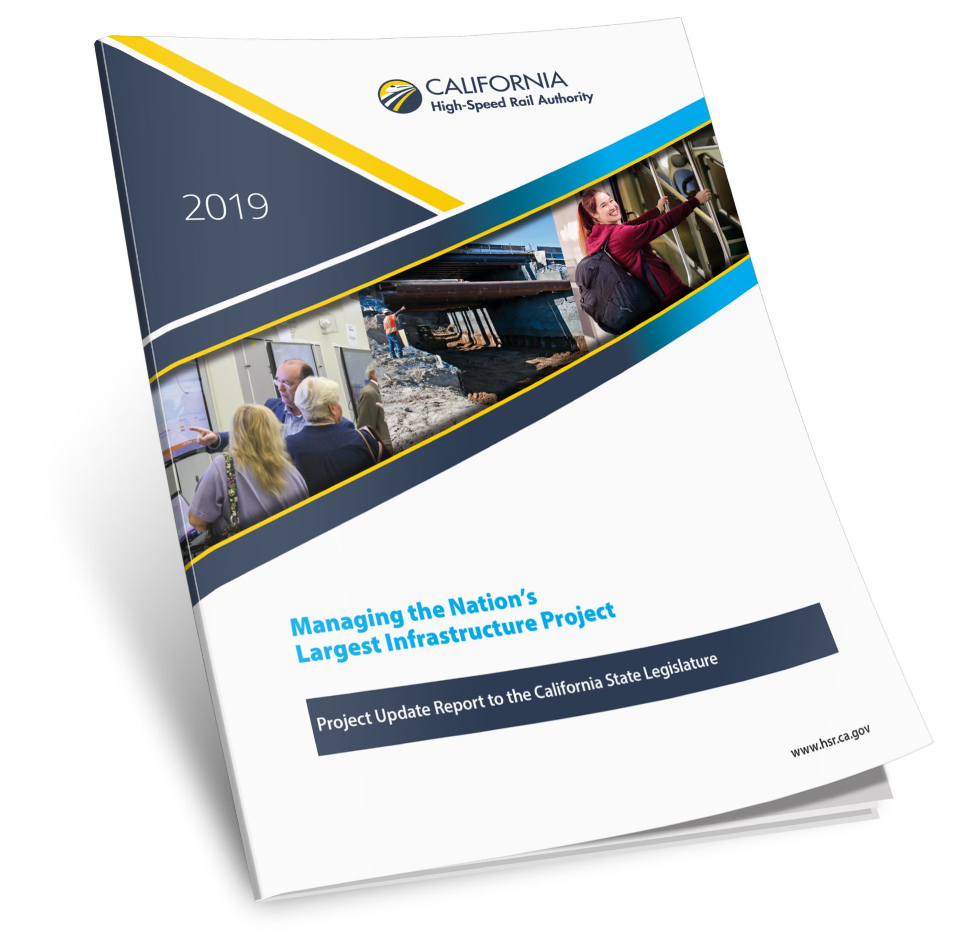
Senate joint informational hearing California high-speed rail authority
DELIVERING HSR WHILE LIVING WITHIN OUR MEANS
On May 1, 2019, the Authority, will release a Project Update Report to the Legislature outlining the ETO analysis for early operations, benefits, risks, costs and schedule, as well as an implementation plan.
20

Slide 21
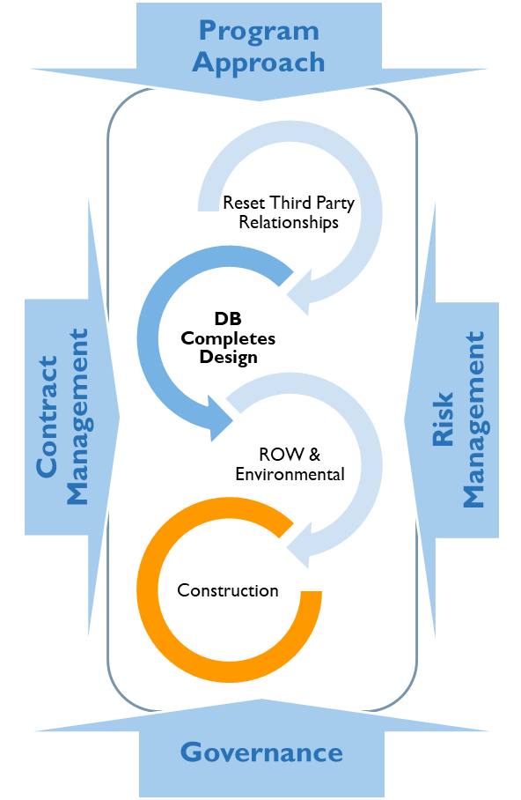
Overarching strategy Applying lessons learned in the central valley
Third Parties: Reset Relationships
Reinstitute Master Agreement Terms & Conditions
Define and finalize requirements & scope
Actively engage in consultation and design reviews
Design Builder (DB) Completes Designs
Defines project footprint for right of way acquisition and environmental clearance
Predecessor to construction
Right of Way (ROW) & Environmental
ROW: Define - Map - Acquire
Environmental clearance
Holistic Program Approach
Integrated Risk Management & Mitigation
Engaged Contract Management
Transparency & Accountability through Governance

Slide 22
Program approach critical actions
Action | Result
Increased presence of Chief and Deputy Chief Operating Officers in the Central Valley | North to South review of alignments to verify “Get-to-Work” Schedules Improved dialogue through monthly meetings with DB Executives
Dedicated “Strike Team” to focus Authority effort in the Central Valley | Resolve multiple-year “legacy” issues Increase collaboration with Project and Construction Manager (PCM) Resolve issues and open worksites for DB Contractors Increased PCM guidance
Separated Contract Operations from Commercial Oversight for more efficient execution | Improved capacity for commercial oversight Increased ability to manage contract performance
Optimizing staff & making additional critical hires | Increase in State contract management staff Develop staff through Design-Build contract training
Improved Construction Package project controls | Increased accountability and enhancing performance

Slide 23
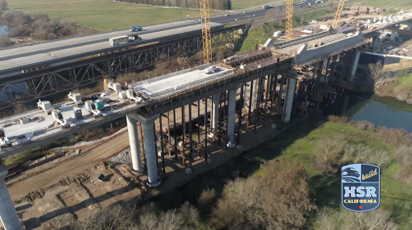
CONSTRUCTION PACKAGE 1 JANUARY 2019
Total Guideway Miles: 25
 | Jan
In Progress | 7.25
Completed | 0
Total | 7.25
Total Structures: 31
 | Jan
In Progress | 7
Completed | 4
Total | 11
ROAD 27
FRESNO RIVER VIADUCT
AVENUE 15
COTTONWOOD CREEK
Construction in Progress
AVENUE 12
Not Cleared for Construction
AVENUE 11
Projected Construction Completion
On Hold for Utility Relocation
AVENUE 8
SAN JOAQUIN RIVER VIADUCT
99 REALIGNMENT
FRESNO TRENCH
TUOLUMNE STREET BRIDGE
CEDAR VIADUCT
MUSCAT AVE
AMERICAN AVENUE

Slide 24
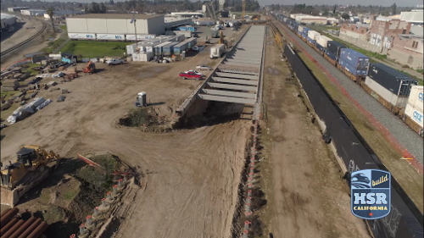
CONSTRUCTION PACKAGE 1 December 2019
Total Guideway Miles: 25
 | Jan | Jun | Dec
In Progress | 7.25 | 12 | 18.5
Completed | 0 | 0 | 0
Total | 7.25 | 12 | 18.5
Total Structures: 31
 | Jan | Jun | Dec
In Progress | 7 | 9 | 10
Completed | 4 | 6 | 10
Total | 11 | 15 | 20
ROAD 27
FRESNO RIVER VIADUCT
AVENUE 15 1/2
AVENUE 15
COTTONWOOD CREEK
AVENUE 12
Construction in Progress
AVENUE 11
Not Cleared for Construction
AVENUE 10
Projected Construction Completion
AVENUE 9
AVENUE 8
On Hold for Utility Relocation
AVENUE 7
SAN JOAQUIN RIVER VIADUCT
HERNDON AVE
99 REALIGNMENT
MCKINLEY AVENUE
BELMONT AVENUE
FRESNO TRENCH
TUOLUMNE STREET BRIDGE
GOLDEN STATE BLVD
CEDAR VIADUCT
MUSCAT AVE
AMERICAN AVENUE

Slide 25
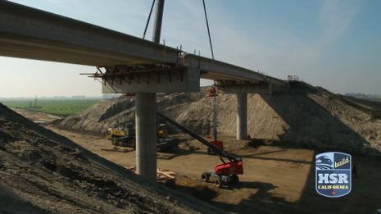
CONSTRUCTION PACKAGE 2-3 January 2019
Total Guideway Miles: 65
 | Jan
In Progress | 21
Completed | 12
Total | 33
Total Structures: 50
 | Jan
In Progress | 3
Completed | 0
Total | 3
DAVIS AVE
EXCELSIOR AVE
KENT AVE
KANSAS AVE
CORCORAN HWY
Construction in Progress
Not Cleared for Construction
Projected Construction Completion

Slide 26
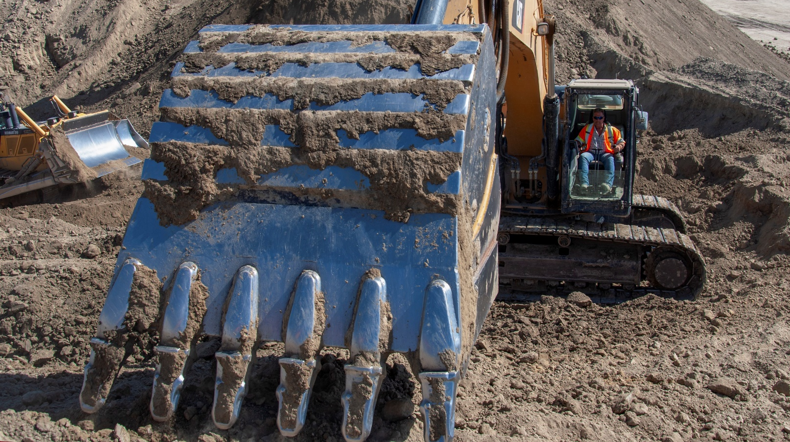
CONSTRUCTION PACKAGE 2-3 DECEMBER 2019
LINCOLN AVE
Total Guideway Miles: 65
 | Jan | Jun | Dec
In Progress | 21 | 23 | 28
Completed | 12 | 22 | 37
Total | 33 | 45 | 65
Total Structures: 50
 | Jan | Jun | Dec
In Progress | 3 | 7 | 14
Completed | 0 | 0 | 4
Total | 3 | 7 | 18
ADAMS AVE
SOUTH AVE
MOUNTAIN VIEW AVE
CANEJO AVE
PEACH AVE
DAVIS AVE
EXCELSIOR AVE
FLINT AVE
FARGO AVE
IDAHO AVE
JACKSON AVE
KENT AVE
KANSAS AVE
CORCORAN HWY
AVE 88
Construction in Progress
Not Cleared for Construction
Projected Construction Completion

Slide 27
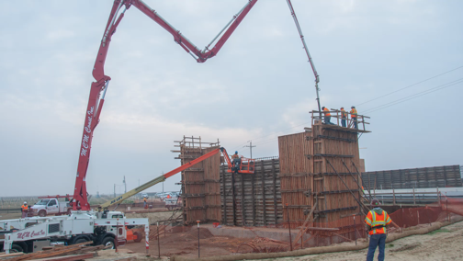
CONSTRUCTION PACKAGE 4 January 2019
Total Guideway Miles: 21
 | Jan
In Progress | 11
Completed | 0
Total | 11
Total Structures: 11
 | Jan
In Progress | 3
Completed | 0
Total | 3
GARCES HWY
POND ROAD
WASCO VIADUCT
Construction in Progress
Not Cleared for Construction
Projected Construction Completion

Slide 28
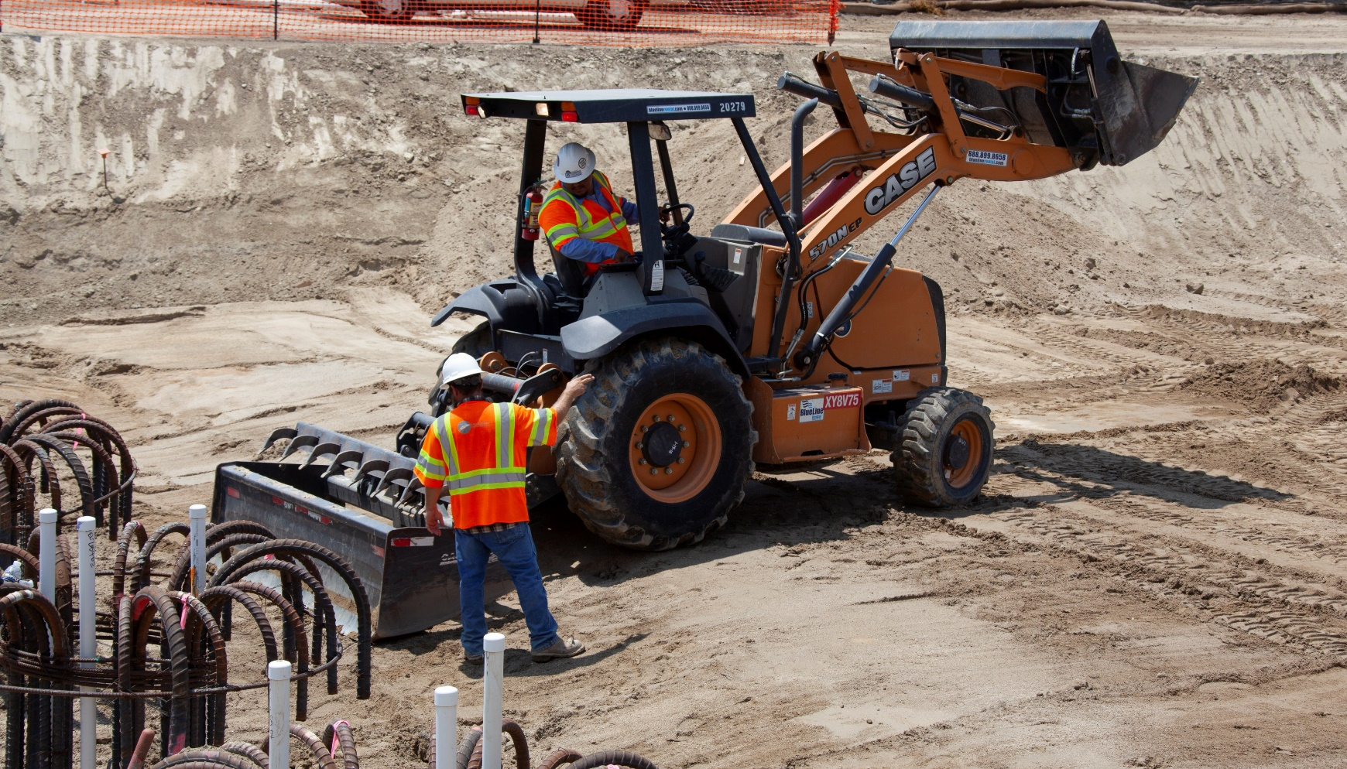
CONSTRUCTION PACKAGE 4 December 2019
Total Guideway Miles: 21
 | Jan | Jun | Dec
In Progress | 11 | 17 | 11
Completed | 0 | 0 | 10
Total | 11 | 17 | 21
Total Structures: 11
 | Jan | Jun | Dec
In Progress | 3 | 6 | 7
Completed | 0 | 0 | 4
Total | 3 | 6 | 11
GARCES HWY
POND ROAD
PETERSON ROAD
POSO CREEK
MCCOMBS AVE
STATE ROUTE 46
POSO AVENUE
PEDESTRIAN UP
WASCO VIADUCT
KIMBERLINA ROAD
MERCED AVE
Construction in Progress
Not Cleared for Construction
Projected Construction Completion

Slide 29
Senate joint informational hearing California high-speed rail authority
RESPONSE TO STATE AUDITOR
Authority welcomed the audit and took its recommendations very seriously
Findings and recommendations built on issues we had identified in 2018 Business Plan
Committed to open dialogue and addressing all of the Auditor’s recommendations on the schedule

Slide 30
Senate joint informational hearing California high-speed rail authority
FEDERAL RAILROAD ADMINISTRATION (FRA) GRANT AGREEMENT
February 19th – FRA sent letter threatening to de-obligate $929 million in federal FY 10 funds.
March 4th – Authority sent two letters in response, specifically:
Project continues to further purpose for which federal funds were obligated;
We are making steady progress toward meeting grant requirements;
Noted that FRA has taken actions detrimental to timely progress on environmental reviews;
Inviting FRA Administrator to help re-establish functional relationship between Authority and the FRA.

Slide 31
2018 Economic Impact Report CALIFORNIA HIGH-SPEED RAIL AUTHORITY
Direct Investment
Total Authority Expenditures that drive the Economic Output
JULY 2006
$4.8 Billion
JUNE 2018
$4.8 Billion from July 2006 through June 2017
95% Went to California Firms and Workers

Slide 32
2018 Economic Impact Report CALIFORNIA HIGH-SPEED RAIL AUTHORITY
California State Wide Economic Impacts
2006 - 2018
JOB-YEARS OF
EMPLOYMENT
Job Years - Job-Years are the equivalent number of one-year-long, full-time jobs supported by the project.
37,600 – 42,600

Slide 33
2018 Economic Impact Report CALIFORNIA HIGH-SPEED RAIL AUTHORITY
California State Wide Economic Impacts
2006 - 2018
LABOR INCOME
Labor income includes all forms of employment income, including compensation (wages, benefits, and payroll taxes) firms paid to employees, and income earned by self-employed workers or unincorporated sole proprietorships.
$2.60 - $2.99 BILLION

Slide 34
2018 Economic Impact Report CALIFORNIA HIGH-SPEED RAIL AUTHORITY
California State Wide Economic Impacts
2006 - 2018
ECONOMIC OUTPUT
Economic Output - Economic output represents the total contribution the Program has made to the Gross Domestic Product (GDP) in California and the US or the economic “value-add”.
$6.8 - $7.6
Billion

Slide 35
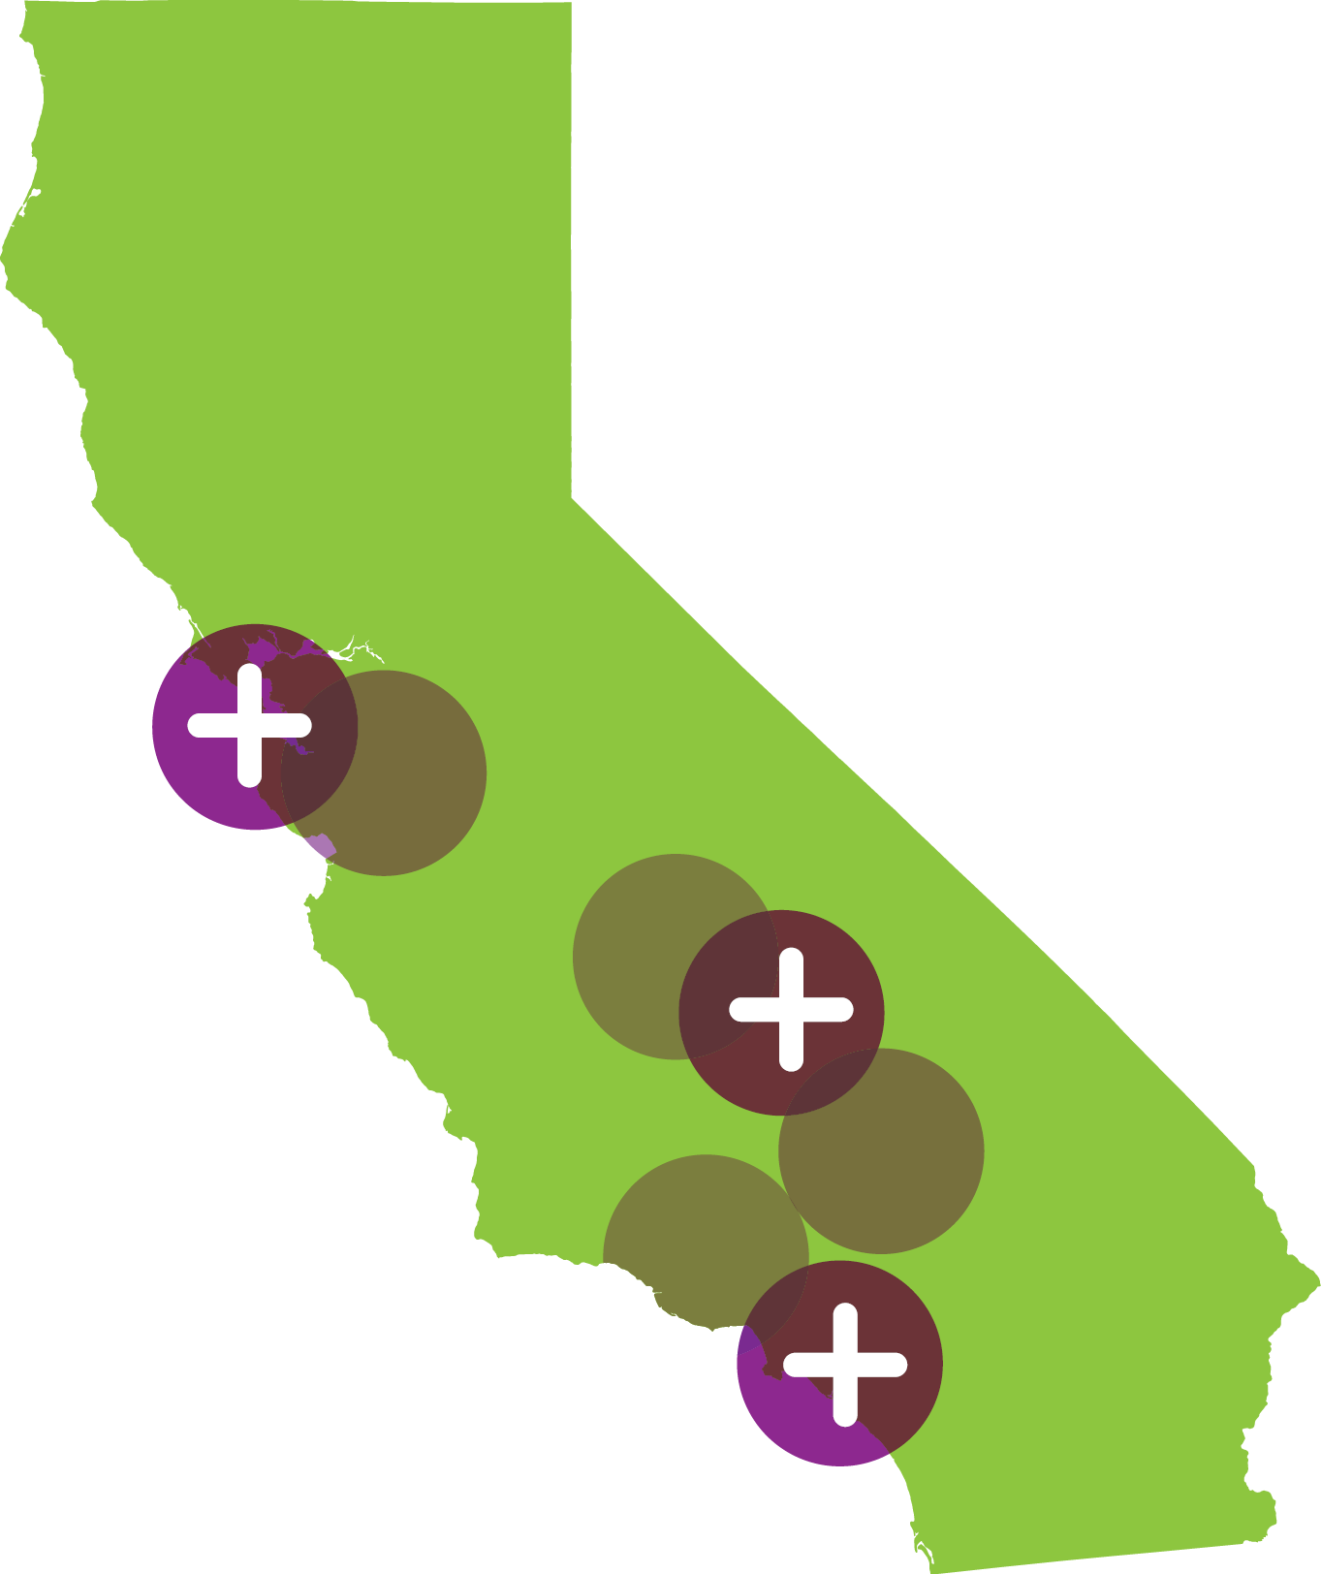
2018 Economic Impact Report CALIFORNIA HIGH-SPEED RAIL AUTHORITY
Direct Investments
2006 - 2018
54%
of project expenditures occurred in designated disadvantaged communities throughout California, spurring economic activity in these areas.

Slide 36
2018 Economic Impact Report CALIFORNIA HIGH-SPEED RAIL AUTHORITY
Direct Investment in Small Businesses
2006 - 2018
488
Small Businesses are either committed, utilized or actively working on the project
The Authority has a 30% Small Business Participation goal including:
10% Disadvantaged Business Enterprises (DBE) participation
3% Disabled Veteran Business Enterprises (DVBE) participation

Slide 37
Senate Joint informational hearing California high-speed rail authority
IMPLEMENTATION STRATEGY SUMMARY
Deliver High-Speed Rail in California by:
Getting trains on the ground ASAP in the Central Valley, where the environmental work is near completion and construction is underway;
Completing the environmental work statewide by 2022;
Completing our “bookend” commitments in northern and southern California;
Being prepared to expand the system, consistent with Proposition 1A, as federal and/or private funding opportunities materialize.

Slide 38
Senate joint informational hearing California high-speed rail authority
APPROACH TO DELIVERY SUMMARY
We are working to get high-speed rail operational in California by:
Being transparent on opportunities and challenges;
Maintaining our Commitments to our partners;
Delivering High-Speed Rail while ‘living within our means.’

Slide 39
SenatE joint informational hearing California high-speed rail authority
Lenny Mendonca, Board Chairman
(916) 322-0694 lenny.mendonca@gobiz.ca.gov
Brian Annis, Secretary
California Transportation Agency
(916) 323-5401 brian.annis@calsta.ca.gov
Headquarters California High-Speed Rail Authority 770 L Street, Suite 800 Sacramento, CA 95814 www.hsr.ca.gov
instagram.com/cahsra
facebook.com/CaliforniaHighSpeedRail
twitter.com/cahsra
youtube.com/user/CAHighSpeedRail

