Slide 1
Short Term Crisis and Long Term Transformation: How to Bring Back and Build Transit Ridership in California
Emily Loper
Vice President of Public Policy
Bay Area Council
eloper@bayareacouncil.org

Slide 2
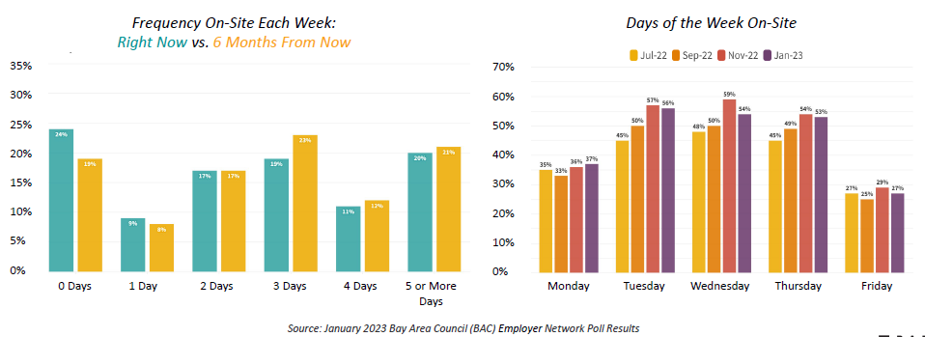
New Bay Area Commute Trends
Source: Bay Area Council Employer Survey, January 2023

Slide 3
Weekday Transit Ridership v. Bridge Traffic
Source: Bay Area Council Economic Institute Transit Recovery Tracker

Slide 4
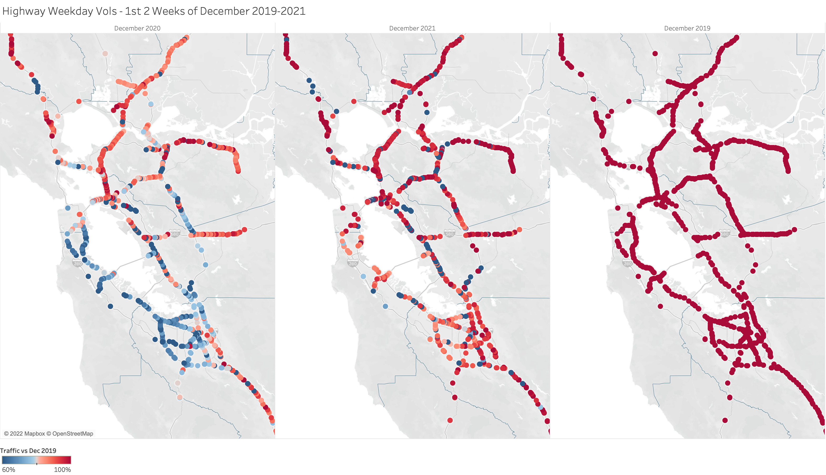
Bay Area Traffic Relative to Dec 2019
Data Source: Caltrans PeMS; First two weeks of December only.
Dec 2020
Dec 2021
Source: MTC Next Generation Bay Area Freeways Study, August 2022

Slide 5
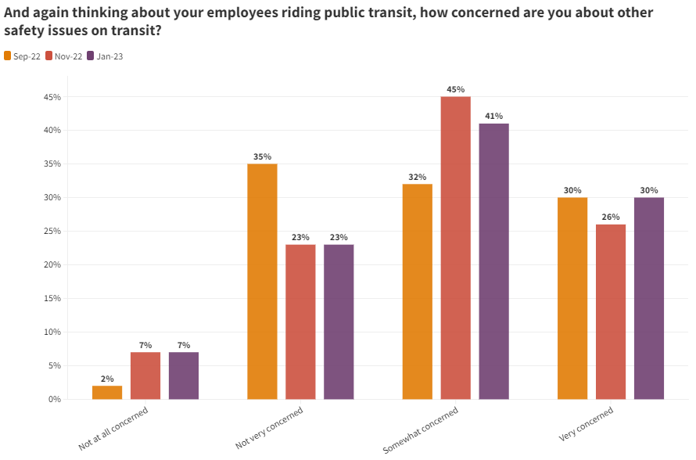
COVID Safety v. Personal Safety Concerns
Source: Bay Area Council Employer Survey, January 2023

Slide 6
Ridership Regrowth Strategies
Improve safety and cleanliness of systems
Ensure reliable and frequent service
Develop more customer-focused system:
Coordinated schedules
Simpler fares and payment
Unified mapping and wayfinding

